Slide 1
3 The Data Link Layer

Slide 2
Highlights
Framing
Error-Control
Error-correction
Error-detection
ARQ (Automatic Repeat reQuest)
Flow control
Stop-Wait
Slide Window
Performance
ADSL、HDLC、SLIP和PPP

Slide 3
3.1 Data Link Layer Design Issues

Slide 4
Data Link Layer Design Issues
Goals
Study the algorithms for achieving reliable, efficient communication between two adjacent machines
Adjacent: two machines are connected by a communication channel that acts conceptually like a wire, bits are delivered in exactly the same order in which they are sent.
Data Link Layer Design Issues
Services Provided to the Network Layer
Framing
Error Control
Flow Control

Slide 5
Services Provided to the Network Layer

Slide 6
Functions of the Data Link Layer
Provide service interface to the network layer
Dealing with transmission errors
Regulating data flow
Slow receivers not swamped by fast senders
Notes:
调节： Regulating

Slide 7
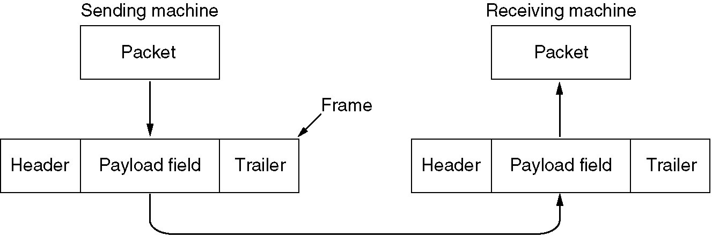
Functions of the Data Link Layer (2)
Relationship between packets and frames.

Slide 8
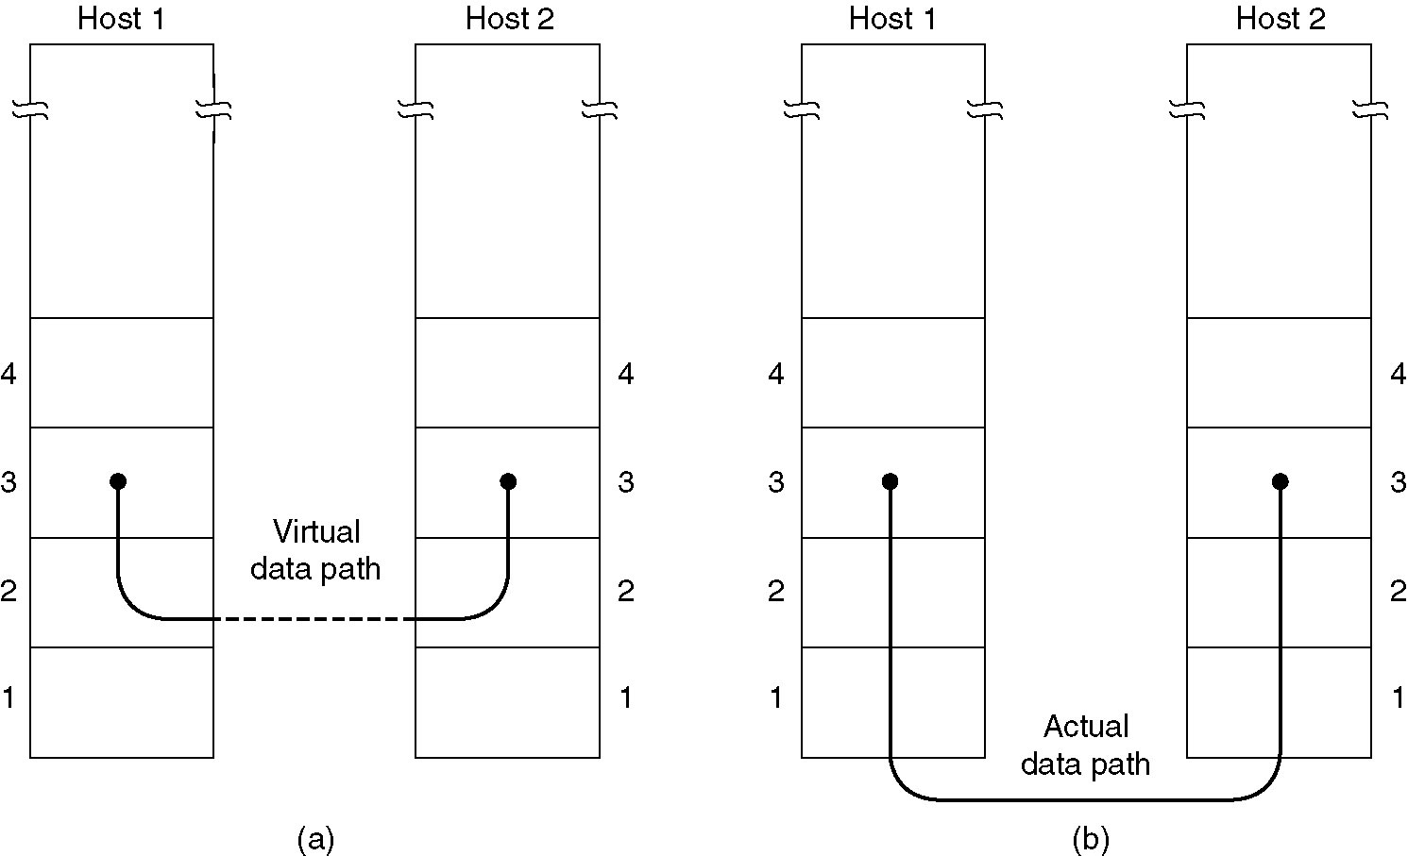
Services Provided to Network Layer
(a) Virtual communication.
(b) Actual communication.

Slide 9
Services Provided to Network Layer(2)
Unacknowledged connectionless service.
Most LANs use unacknowledged connectionless service
Acknowledged connectionless service.
This service is useful over unreliable channels, such as wireless systems
Acknowledged connection-oriented service
10 frames, of which 2 are lost on average. It would then take a very long time for the packet to get through.
Connection establishment
Timer
Sequence number
Notes:
0.8^10=0.1
1/0.1=10

Slide 10
Framing

Slide 11
Framing
A sequence of bits is sent from node A to node B over a point-to-point link. Node B must recognize exactly what set of bits constitutes a frame, that is, it must determine where the frame begins and ends.

Slide 12
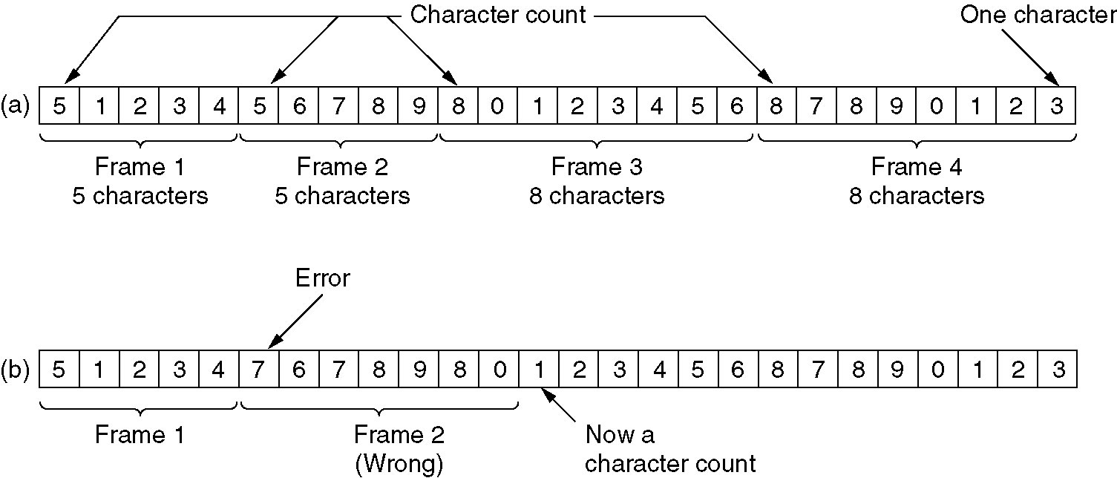
Character Count
Character count(字符计数):
Uses a field in the header to specify the number of characters in the frame (DEC:DDCMP)
A character stream.
(a) Without errors. (b) With one error.

Slide 13
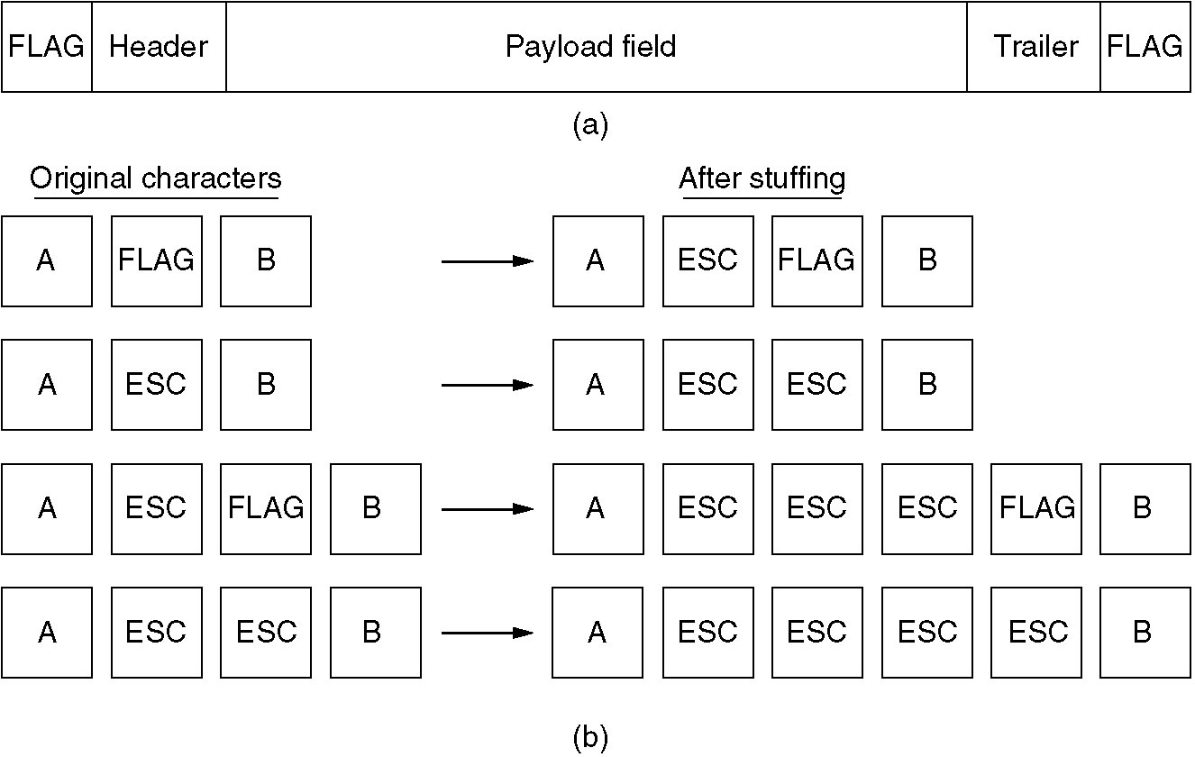
Byte Stuffing
Flag bytes with byte stuffing (字符添充):Having each frame start and end with special bytes (IBM:BISYNC)
(a) A frame delimited by flag bytes.
(b) Four examples of byte sequences before and after stuffing.

Slide 14
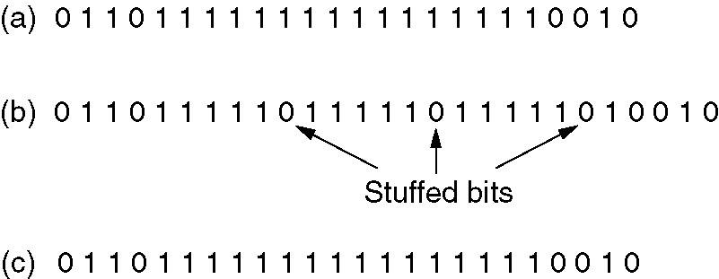
Bit Stuffing
Starting and ending flags, with bit stuffing (比特添充):Each frame begins and ends with a special bit pattern, 01111110 . Whenever the sender's data link layer encounters five consecutive 1s in the data, it automatically stuffs a 0 bit into the outgoing bit stream (Example: HDLC)
(a) The original data.
(b) The data as they appear on the line.
(c) The data as they are stored in receiver’s memory after destuffing.
Notes:
10101111110 111110011 10101010 111110111 01010101 0111 1110 11101110

Slide 15
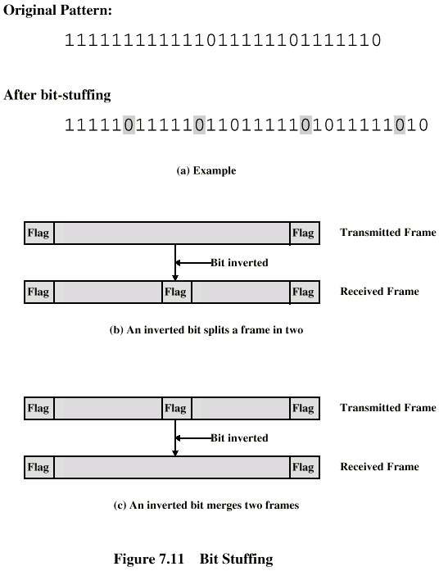
Example with Possible Errors (Bit Stuffing)

Slide 16
比特填充
从信道上收到比特序列： 1101 0111 1110 0111 1110 1101 1011 1110 0010 1100 0101 1111 0101 1001 1111 1001，该比特序列中包含一个完整的帧，用十六进制写出该帧的内容（不包含帧的首尾标志）。
HDLC使用比特填充法成帧，帧定界符为01111110，在帧的内容中若出现连续的5个1，则立即插入1个0，应该去掉加入的0,完整的帧内容：
Notes:
1101 1011 1110 0101 1000 1011 1111 0110
D B E 5 8 B F 6

Slide 17
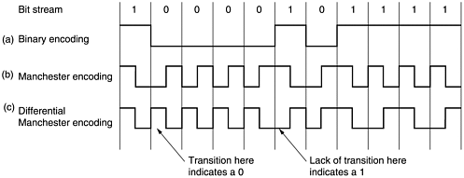
Physical Layer Coding Violations
Physical layer coding violations:物理层编码违例法 (IEEE:802.3)

Slide 18
Error Control & Flow Control

Slide 19
Error Control
Make sure all frames are eventually delivered to the network layer at the destination and in the proper order
Provide the sender with some feedback about what is happening at the other end of the line
Hardware troubles may cause a frame to vanish completely
If either the frame or the ACK is lost, the timer will go off, alerting the sender to a potential problem
Managing the timers and sequence numbers so as to ensure that each frame is ultimately passed to the network layer at the destination exactly once, no more and no less

Slide 20
Flow Control
What to do with a sender that wants to transmit frames faster than the receiver can accept them
Two approaches are commonly used
Feedback-based flow control, the receiver sends back information to the sender giving it permission to send more data or at least telling the sender how the receiver is doing
Rate-based flow control, the protocol has a built-in mechanism that limits the rate at which senders may transmit data, without using feedback from the receiver.

Slide 21
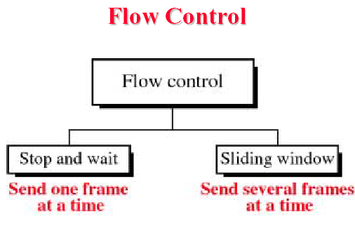
Flow Control

Slide 22
3.2 Error Detection and Correction

Slide 23
Error Control
Classification of Errors
Lost frames: a frame failed to arrive to the other side
Owing to noise burst or dropped from a queue
Damaged frames: some bits are in error
Error detection
Parity check: able to detect single bit errors
Cyclic Redundancy Check (CRC): detecting some burst errors
Automatic Repeat reQuest (ARQ)
Error correction
Forward Error Correction (FEC)

Slide 24
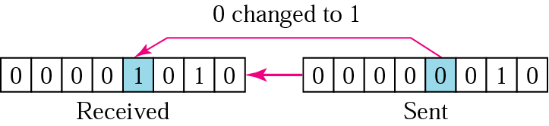
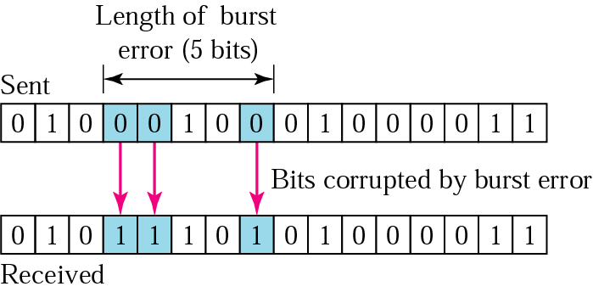
Single-bit Error & Burst Error
Single-bit error, only one bit has changed
A burst error means that 2 or more bits have changed.

Slide 25
Error Correcting Code

Slide 26
Hamming Distance
Hamming distance: The number of bit positions in which two codewords differ
(10001001 and 10110001, Hamming distance = 3)
To detect d errors, need a distance d+1 code
To correct d errors, need a distance 2d+1 code

Slide 27
Example of an Error-Correcting Code
Consider a code with only four valid codewords:
0000000000, 0000011111
1111100000, 1111111111
This code has a distance 5, which means that it can correct 2 errors.
If the codeword 0000000111 arrives, the receiver knows that the original must have been 0000011111
If a triple error changes 0000000000 into 0000000111, the error will not be corrected properly

Slide 28
Hamming code
The number of check bits needed to correct single errors：
m+r+1≤ 2^{r} m: message bits, r:check bits
m message bits and r check bits, 2^{m} legal messages, n = m + r
Each legal message has n illegal codewords at a distance 1 from it
(n + 1)2^{m} ≤ 2^{n}
(m + r + 1) ≤ 2^{r}.
Example: m=7,r≥4

Slide 29
Hamming code
The bits of the codeword are numbered, start with 1 at left end, bit 2 to its immediate right, and so on.
The bits that are powers of 2 (1, 2, 4, 8, 16, etc.) are check bits. Each check bit forces the parity of some collection of bits, including itself, to be even (or odd).
The rest (3, 5, 6, 7, 9, etc.) are filled up with the m data bits
even parity ‘H’ 100,1000
Bit number | 1 | 2 | 3 | 4 | 5 | 6 | 7 | 8 | 9 | 10 | 11
Bit value | ？ （0） | ？ | 1 | ？ | 0 | 0 | 1 | ？ | 0 | 0 | 0
3=1+2， 5=1+4， 6=2+4， 7=1+2+4 , 9=1+8,
10=2+8, 11=1+2+8 so bit1 (3,5,7,9,11)

Slide 30
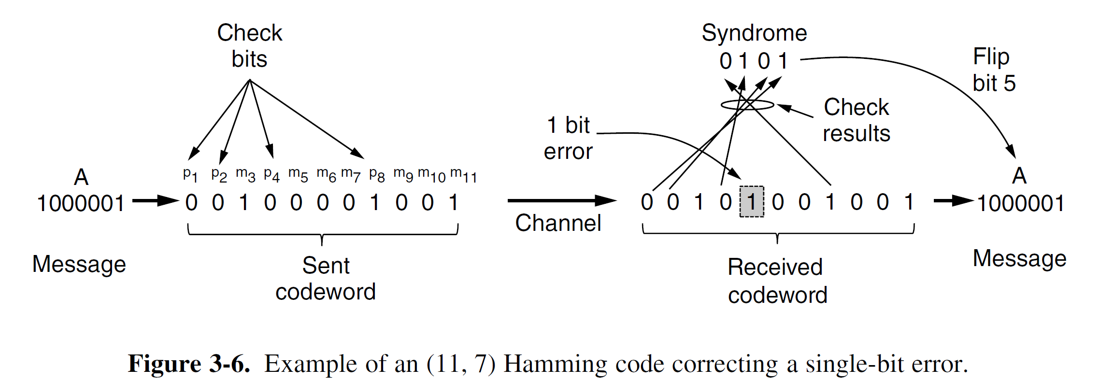
Error Crrection

Slide 31
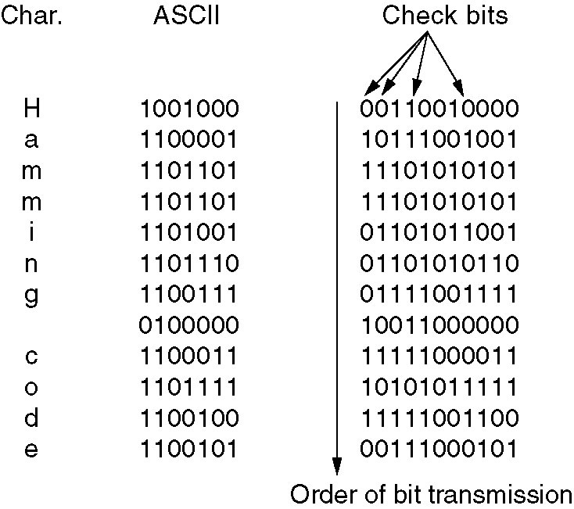
Hamming code: Correct burst errors
Use of a Hamming code to correct burst errors.

Slide 32
Other error-correcting codes
Binary convolutional codes.
Reed-Solomon codes.
Low-Density Parity Check codes.

Slide 33
Error Detecting Code

Slide 34
Detection code
1、Parity
2、Checksums
3、Cyclic Redundancy Checks (CRCs)

Slide 35
Error Correcting & Detecting
On channels that are reliable, such as fiber, it is cheaper to use an error detecting code and just retransmit the occasional block found to be faulty
On channels such as wireless links that make many errors, it is better to add enough redundancy to each block for the receiver to be able to figure out what the original block was
Example (single-bit error)
Bit Error Rate BER=10⁻⁶, 1Block=1000bits, Data=1M bits
The overhead
Error detection + retransmission: 2001 bits
Hamming code : 10,000 bits
(m + r + 1) ≤ 2^{r}

Slide 36
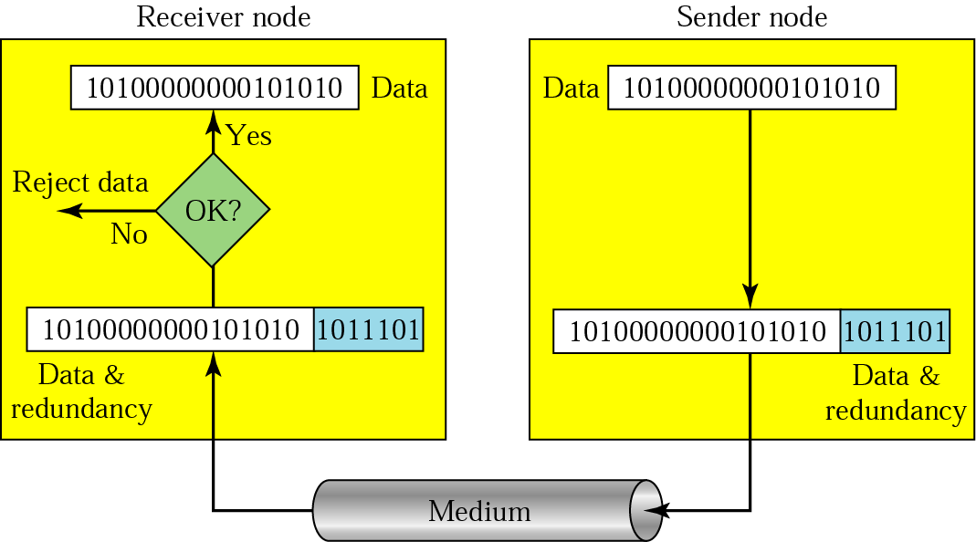
Error Detecting Codes

Slide 37
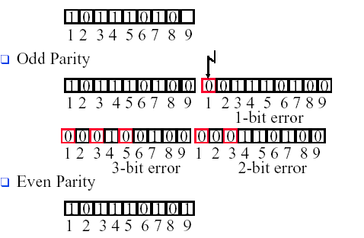
Odd & Even Parity
Odd & Even parity

Slide 38
Odd & Even Parity
Coding
Each block to be sent is regarded as a matrix
A parity bit is computed separately for each column and affixed to the matrix as the last row
The matrix is then transmitted one row at a time.
Performance
Can detect a single burst of length n
A burst of length n + 1 will pass undetected if the first bit is inverted, the last bit is inverted, and all the other bits are correct
n
10010001
01010011
10100001
01010110
11001100
11101101
10001000
10011110

Slide 39
Checksums
Word Cksum(Word *Buf, Word Num_Words)
{
Dword Sum;
for ( Sum=0; Num_Words>0; Num_Words--)
Sum+=*Buf++;
Sum = ( Sum >> 16 ) + ( Sum & 0xffff );
Sum += Sum >> 16;
return ~Sum;
}

Slide 40
Polynomial Code
Also known as CRC (Cyclic Redundancy Check)
Treating bit strings as representations of polynomials with coefficients of 0 and 1
A k-bit frame is regarded as the coefficient list for a polynomial with k terms, ranging from x^{k-1} to x⁰: 110001=> x⁵ + x⁴ + x⁰
Polynomial arithmetic is done modulo 2, addition and subtraction are identical to XOR
The algorithm for computing the checksum:
The degree of generator polynomial G(x), is r
Append r zero bits to the low-order end of the frame（x^{r} M(x) ）
Divide the bit string corresponding to G(x), using modulo 2 division
Subtract the remainder from the bit string using modulo 2 subtraction （T(x)）

Slide 41
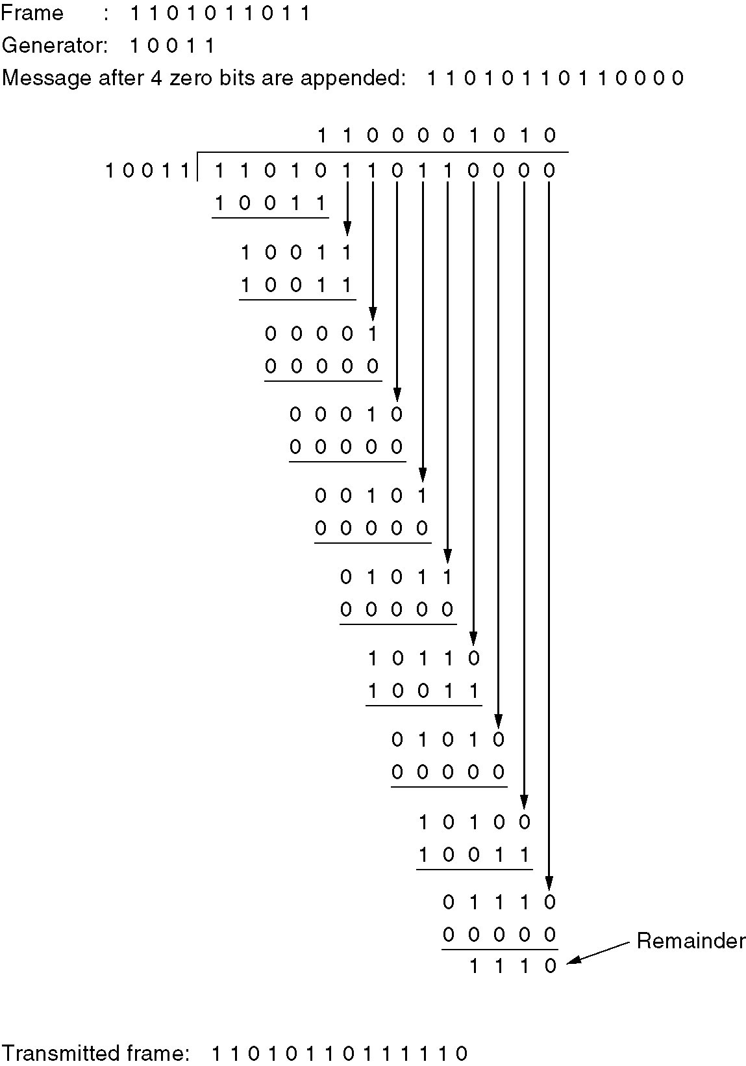
Calculation of the
polynomial code checksum.

Slide 42
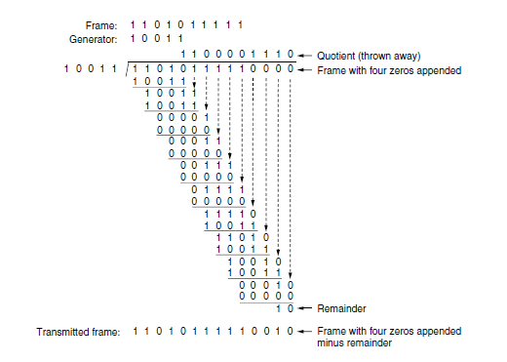
CRC code

Slide 43
The Power of CRC (1)
Imagine that a transmission error occurs, so that instead of the bit string for T(x) arriving, T(x) + E(x) arrives.
Upon receiving the checksummed frame, the receiver computes [T(x) + E(x)]/G(x). T(x)/G(x) is 0, so the result is E(x)/G(x). Those errors that happen to correspond to polynomials containing G(x) as a factor will slip by; all other errors will be caught.

Slide 44
The Power of CRC (2)
A polynomial code with r check bits will detect all burst errors of length ≤ r
By making x+1 a factor of G(x), we can catch all errors consisting of an odd number of inverted bits
Burst length is r + 1 ，an incorrect frame being accepted as valid is ½^{r – 1}.
The probability of a bad frame(Burst length is longer than r + 1 ) getting through unnoticed is ½^{r}, assuming that all bit patterns are equally likely

Slide 45
Generator Polynomial
Certain polynomials have become international standards
CRC-16
x¹⁶+x¹⁵+x²+1
CRC-CCITT (HDLC)
x¹⁶+x¹²+x⁵+1
CRC-32 (IEEE802)
x³²+x²⁶+x²³+x²²+x¹⁶+x¹²+x¹¹+x¹⁰+x⁸+x⁷+x⁵+x⁴+x²+x¹+1

Slide 46
The Calculation of CRC
Hardware
A simple shift register circuit can be constructed to compute and verify the checksums
Software
static u16 fcstab[256] = {
0x0000, 0x1189, 0x2312, 0x329b, 0x4624, 0x57ad, 0x6536,
0x74bf, 0x8c48, 0x9dc1, 0xaf5a, 0xbed3, 0xca6c, 0xdbe5,
……
0xd49d, 0xc514, 0xb1ab, 0xa022, 0x92b9, 0x8330, 0x7bc7,
0x6a4e, 0x58d5, 0x495c, 0x3de3, 0x2c6a, 0x1ef1, 0x0f78
};
u16 fcs16(u16 fcs, unsigned char *cp, int len)
{
while (len--)
fcs = (fcs >> 8) ^ fcstab[(fcs ^ *cp++) & 0xff];
return (fcs);
}
Notes:
链路层第一次作业

Slide 47
3.3 Elementary Data Link Protocols

Slide 48
Elementary Data Link Protocols
An Unrestricted Simplex Protocol
A Simplex Stop-and-Wait Protocol
A Simplex Protocol for a Noisy Channel

Slide 49
Protocol Definitions

Slide 50
Elementary Data Link Protocols
Some of the assumptions
Physical layer, data link layer, and network layer are independent processes
Machine A wants to send a long stream of data to machine B, using a reliable, connection-oriented service
Machines do not crash
There exist suitable library procedures to_physical_layer to send a frame and from_physical_layer to receive a frame

Slide 51
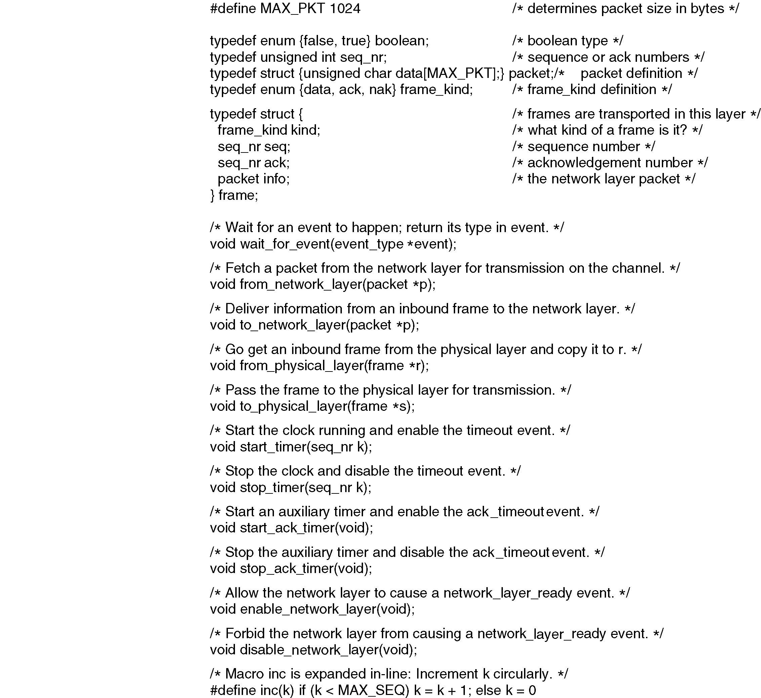
Protocol Definitions
Some definitions needed in the protocols to follow. These are located in the file protocol.h.

Slide 53
Protocol 1: Utopia

Slide 54
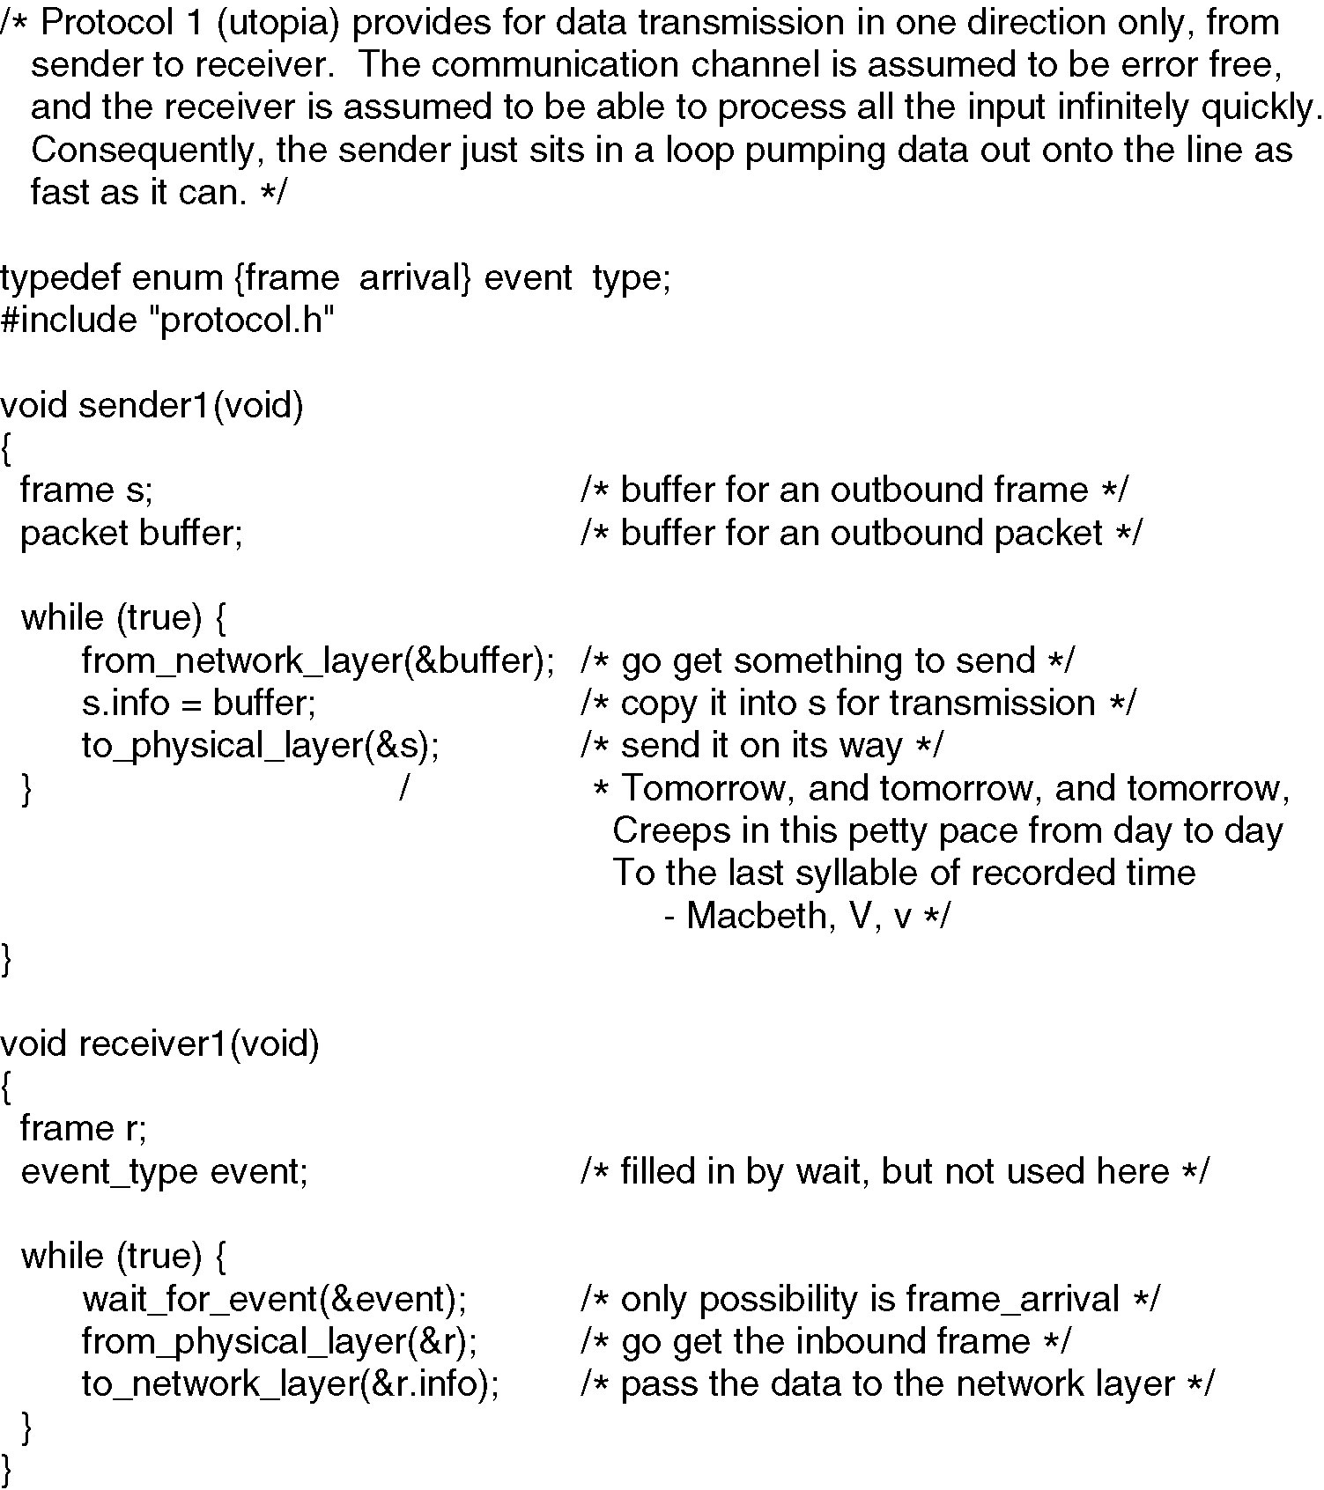

Slide 55
Protocol 2:
Stop-and-Wait Protocol for a Error-free Channel

Slide 56
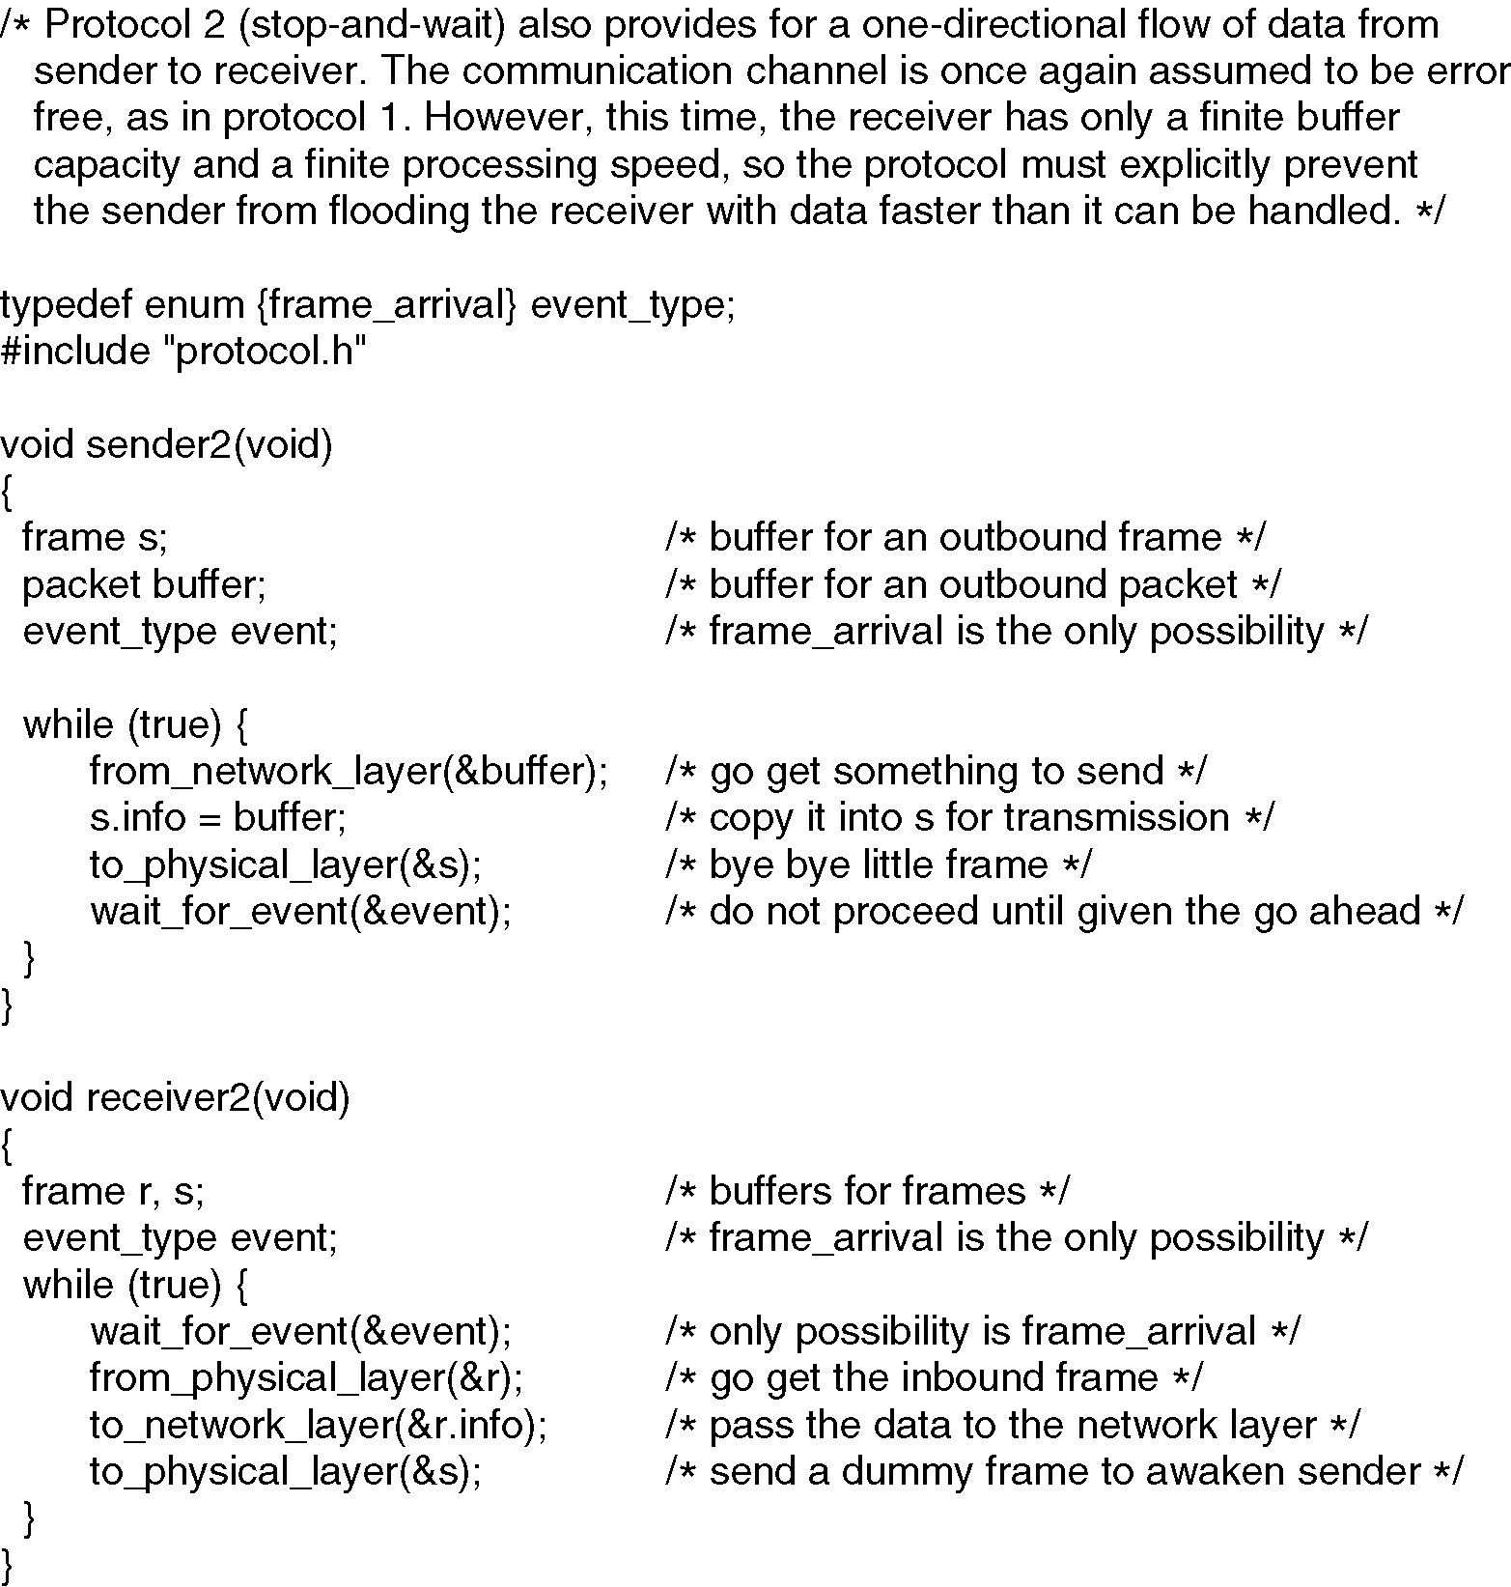

Slide 57
Protocol 3:
A Simplex Protocol for a Noisy Channel

Slide 58
Stop-And-Wait
A
B
A
B
A
B
A
B
DATA
DATA
Err
DATA
Lost
！
DATA
ACK
NAK
t_{out}
t_{out}
Lost
！
ACK
DATA
DATA
DATA
DATA
Time
ACK
ACK
ACK
ACK
(a) Normal
(b) Data Error
(c) Data Lost
(d) ACK Lost

Slide 59
Problems
Case 1: Protocol failed on receiver
The network layer on A gives packet 1 to its data link layer. The packet is correctly received at B and passed to the network layer on B. B sends an ACK frame back to A.
The ACK gets lost completely
The data link layer on A eventually times out. Not having received an acknowledgement, it sends the frame containing packet 1 again
The duplicate frame also arrives B and is passed to the network layer
Case 2: Protocol failed on Sender
A delayed ACK

Slide 60
Sequence Number
Distinguish a frame that it is seeing for the first time from a retransmission
Put a sequence number in the header of each frame
What is the minimum number of bits needed for the sequence number?
链路层：1比特，编号空间大小为2
传输层：1比特编号空间太小，需要较大的编号空间使得在编号回卷时，保证同编号的旧帧不可能被缓冲在网络中，如：TFTP

Slide 61
Sender
从网络层获取一个分组放入buffer
发送buffer中的数据，新启动定时器
label1:
wait_for_event()
switch (event) {
case 收到了坏帧(校验和错):
重发缓冲在buffer里的数据，重新启动定时器
case 定时器超时：
重发缓冲在buffer里的数据，新启动定时器
case 收到校验和正确的帧：
if（ack序号正确） {
关闭旧定时器
从网络层获取下一个分组放入buffer
发送buffer中的数据，新启动定时器
} else
重发缓冲在buffer里的数据，重新启动定时器
}
goto label1

Slide 62
Sender
从网络层获取一个分组放入buffer
发送buffer中的数据，新启动定时器
label1:
wait_for_event()
switch (event) {
case 收到了坏帧(校验和错):
重发缓冲在buffer里的数据，重新启动定时器
case 定时器超时：
重发缓冲在buffer里的数据，新启动定时器
case 收到校验和正确的帧：
if（ack序号正确） {
关闭旧定时器
从网络层获取下一个分组放入buffer
发送buffer中的数据，新启动定时器
} else
重发缓冲在buffer里的数据，重新启动定时器
}
goto label1

Slide 63
Sender
从网络层获取一个分组放入buffer
发送buffer中的数据，启动定时器
while(true) {
wait_for_event()
if (收到校验和正确的帧) {
if（ack序号正确） {
关闭旧定时器
从网络层获取下一个分组放入buffer
}
}
发送buffer中的数据，启动定时器
}

Slide 64
Sender
从网络层获取一个分组放入buffer
while(true) {
发送buffer中的数据，启动定时器
wait_for_event()
if (收到校验和正确的帧) {
if（ack序号正确） {
关闭旧定时器
从网络层获取下一个分组放入buffer
}
}
}

Slide 65
Sender
从网络层获取一个分组放入buffer
next_frame_to_send = 0;
while(true) {
发送buffer中的数据，启动定时器
帧序号填写为next_frame_to_send
wait_for_event()
if (收到校验和正确的帧) {
if（ack序号正确） {
关闭旧定时器
从网络层获取下一个分组放入buffer
inc(next_frame_to_send)
}
}
}
（next_frame_to_send 记录目前缓冲在buffer中的数据的编号。
buffer中装入下一个数据， next_frame_to_send 加1）

Slide 66
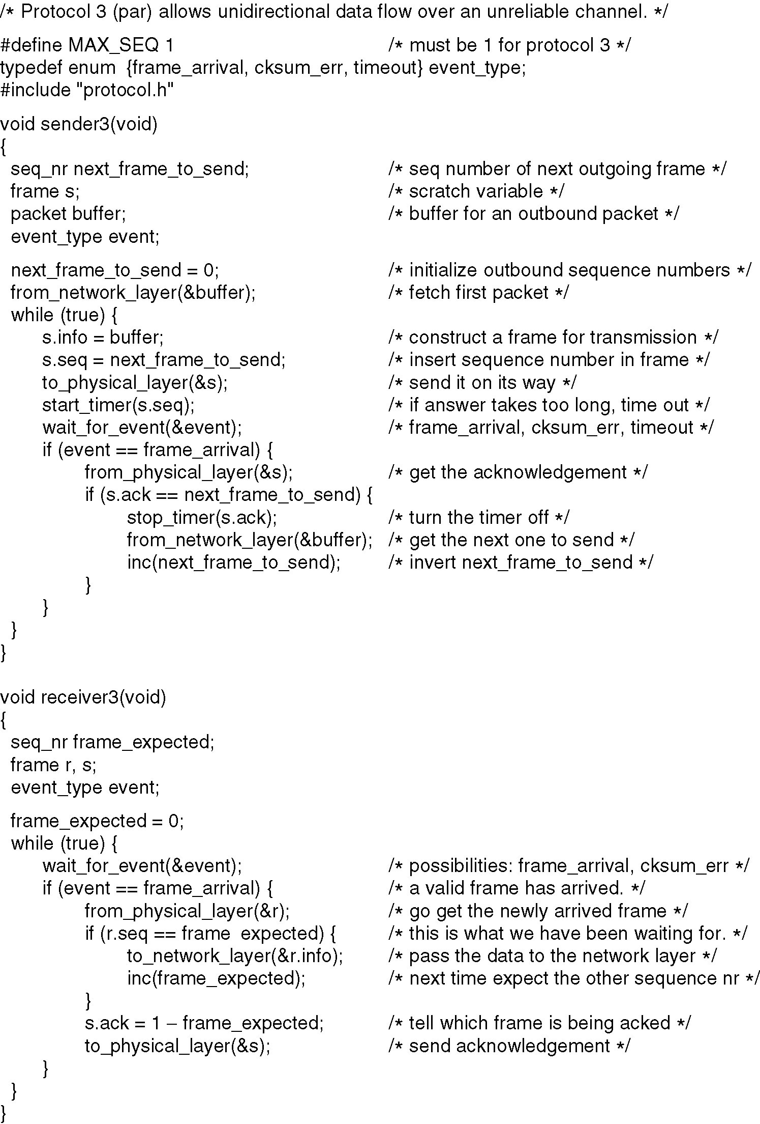
Sender

Slide 67
frame_expected=0
while(true) {
wait_for_event()
switch(event) {
case 坏帧：
do_nothing
case 收到校验和正确的数据帧:
if（序号==frame_expected） {
向网络层上交分组
回ACK（序号为frame_expected)
inc(frame_expected)
} else {
回ACK（序号为frame_expected-1)
}
}
}
Receiver

Slide 68
frame_expected=0
while(true) {
wait_for_event()
if (event==收到校验和正确的数据帧) {
if（序号==frame_expected） {
向网络层上交分组
inc(frame_expected)
回ACK（序号为frame_expected-1)
} else {
回ACK（序号为frame_expected-1)
}
}
}
Receiver

Slide 69
frame_expected=0
while(true) {
wait_for_event()
if (event==收到校验和正确的数据帧) {
if（序号==frame_expected） {
向网络层上交分组
inc(frame_expected)
}
回ACK（序号为frame_expected-1)
}
}
Receiver

Slide 70
Receiver
A positive acknowledgement with retransmission protocol.

Slide 71
Timer
Timeout
If the timeout interval is set too short, the sender will transmit unnecessary frames. While these extra frames will not affect the correctness of the protocol, they will hurt performance

Slide 72
3.4 Sliding Window Protocols

Slide 73
Piggybacking
For full-duplex data transmission:
Use two separate communication channels and use each one for simplex data traffic
Use the same circuit for data in both directions
Piggybacking
When a data frame arrives, instead of immediately sending a separate control frame, the receiver restrains itself and waits until the network layer passes it the next packet
ACK is attached to the outgoing data frame (using the ack field in the frame header).

Slide 74
Sending window & Receiving window
Sending window
At any instant of time, the sender maintains a set of sequence numbers corresponding to frames it is permitted to send. These frames are said to fall within the sending window
Receiving window
Receiver also maintains a receiving window corresponding to the set of frames it is permitted to accept

Slide 75
Sliding Window Protocols
A One-Bit Sliding Window Protocol
A Protocol Using Go Back N
A Protocol Using Selective Repeat

Slide 76
One-Bit Sliding Window Protocol

Slide 77
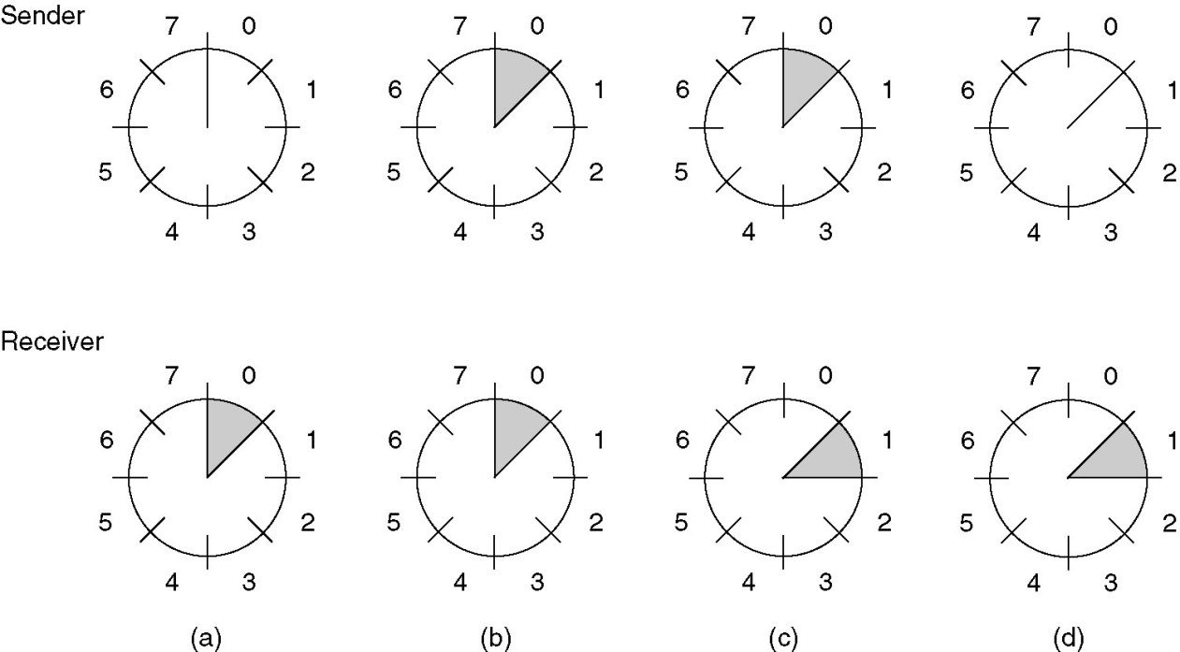
Sliding Window of Size 1
A sliding window of size 1, with a 3-bit sequence number.
(a) Initially.
(b) After the first frame has been sent.
(c) After the first frame has been received.
(d) After the first acknowledgement has been received.

Slide 78
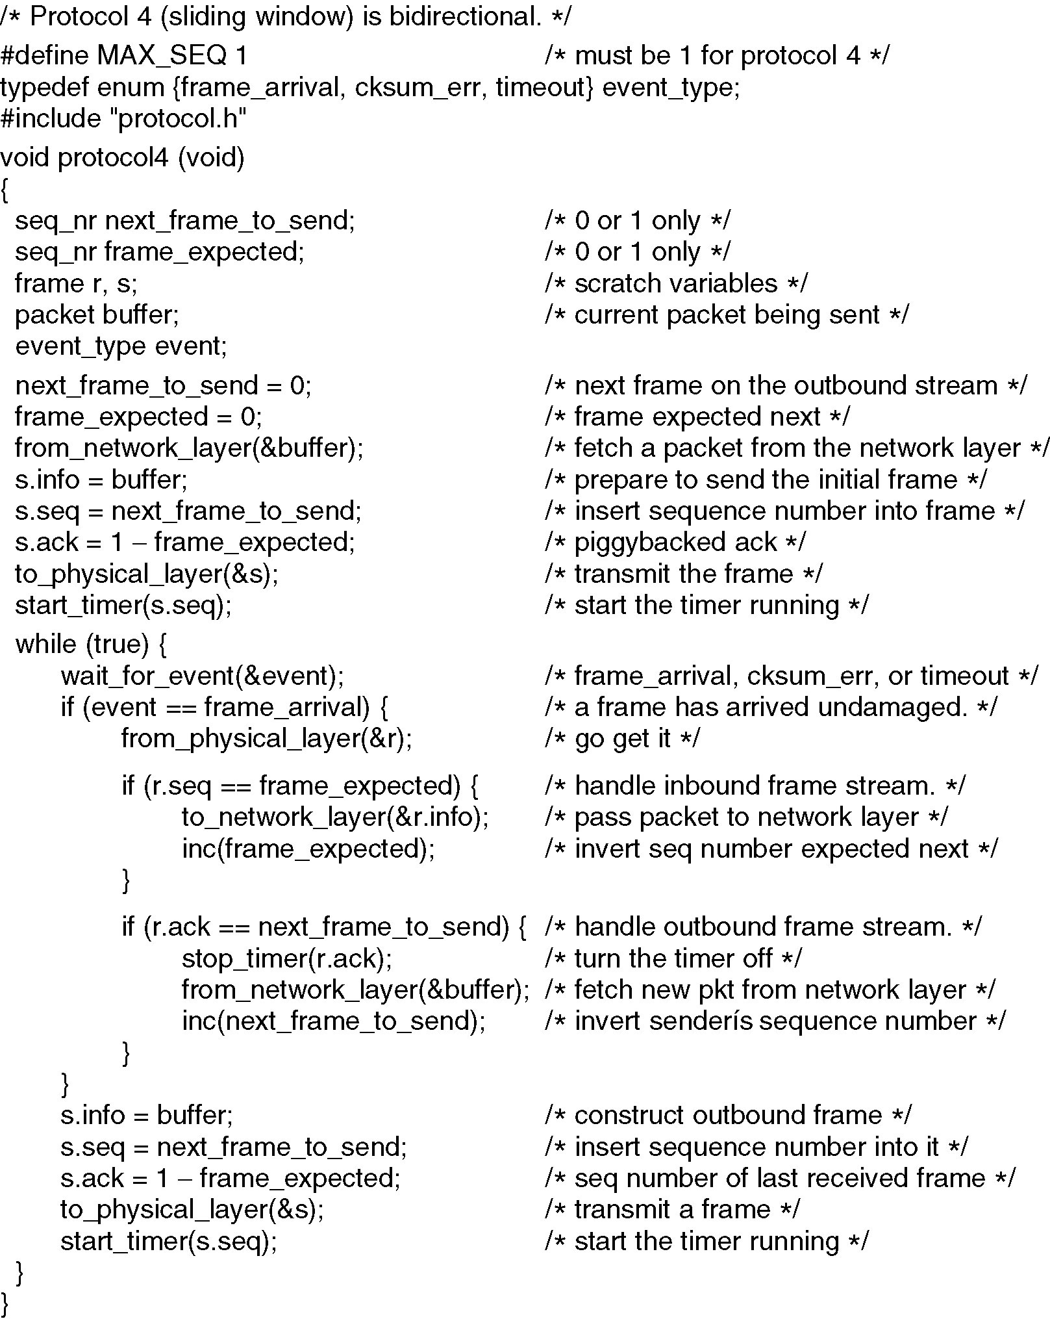
One-Bit Sliding Window Protocol (1)

Slide 79
One-Bit Sliding Window Protocol (2)

Slide 80
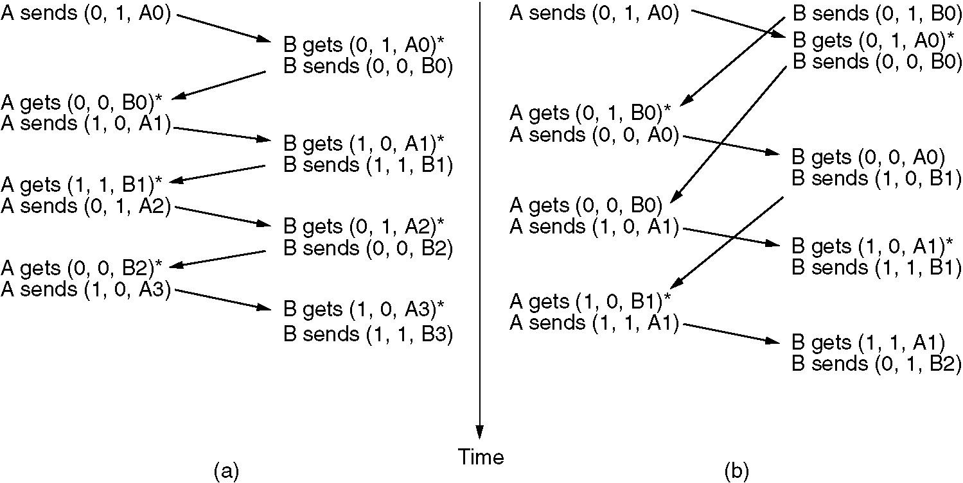
Two Scenarios for Protocol 4
Two scenarios for protocol 4.
The notation is (seq, ack, packet)
An asterisk indicates where a network layer accepts a packet
(a) Normal case. (b) Abnormal case.

Slide 81
Problem
Consider a 50-kbps satellite channel with a 500-msec round-trip propagation delay, send 1000-bit frames
t=0: sender starts sending
t=20 msec: the frame has been completely sent
t=270 msec: frame fully arrived at the receiver
t=520 msec: ACK arrived back at the sender, under the best of circumstances (no waiting in the receiver and a short acknowledgement frame).
Conclusion
Sender was blocked during 500/520 or 96% of the time. only 4% of the available bandwidth was used

Slide 82
Line Utilization
Channel capacity is B bits/sec
Frame size l bits
propagation time R sec
Line Utilization
(l/B)/(l/B+2R)=l/(l+2BR)=1/(1+2BR/l)
If l < 2BR, the efficiency will be less than 50 percent

Slide 83
Protocol Using Go Back N

Slide 84
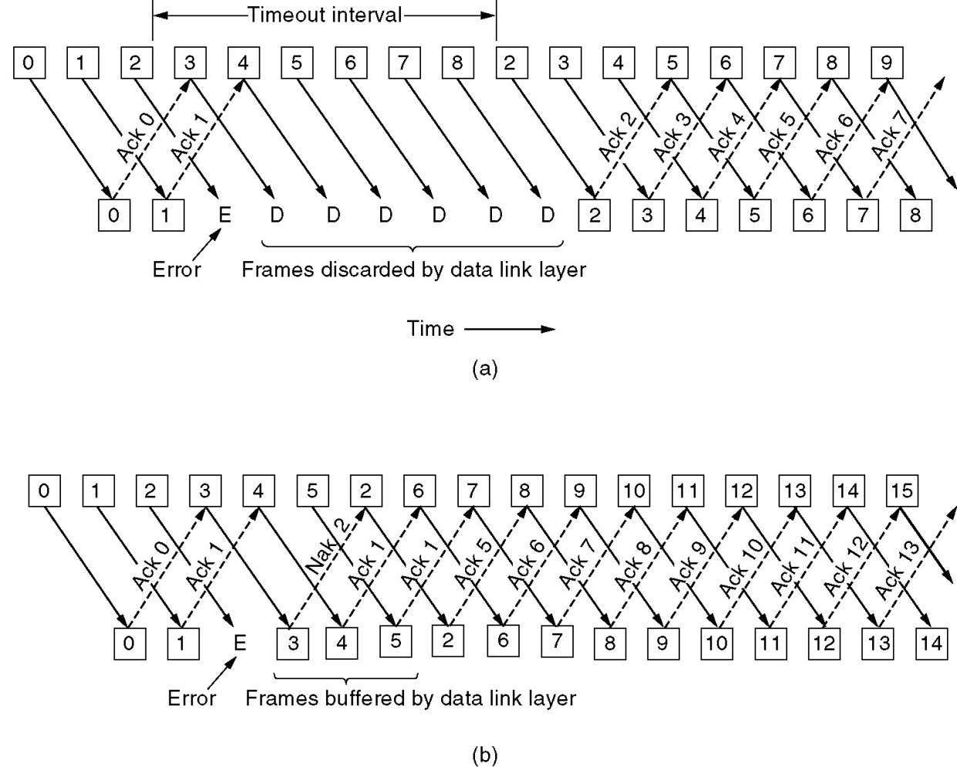
Pipelining & Error Recovery
Pipelining and error recovery. Effect on an error when
(a) Receiver’s window size is 1.
(b) Receiver’s window size is large.

Slide 85
Go Back N（GBN）
Based on sliding window
Use window to control number of outstanding frames
If Receiver detects error, discard that frame and all future frames until error frame received correctly
Transmitter must go back and retransmit that frame and all subsequent frames

Slide 86
Damaged Frame
If Data Frame is Damaged
Receiver detects error in frame i
Receiver discard that frame i and all subsequent
When timeout transmitter retransmits frame i and all subsequent
If ACK Frame is Damaged
Receiver gets frame i and send acknowledgement ACK (i) which is lost
Ack are cumulative, so next ACK(i+n) may arrive before transmitter times out on frame i
If transmitter times out, retransmits frame i and all subsequent

Slide 87
About ACK
A
B
A
0
0
B
ACK0
1
1
ACK1
2
2
ACK2
ACK2

Slide 88
Maximum of Sending Window Size
The sender sends frames 0 through 7.
A piggybacked acknowledgement for frame 7 eventually comes back to the sender.
The sender sends another eight frames, again with sequence numbers 0 through 7.
Now another piggybacked acknowledgement for frame 7 comes in
原则
当发送方发送完发送窗口内所有帧，在未收到ACK之前，接收方正确接收到所有发送来的帧，接收窗口向前推移，此时，必须保证发送窗口与接收窗口在序号上不能重叠

Slide 89
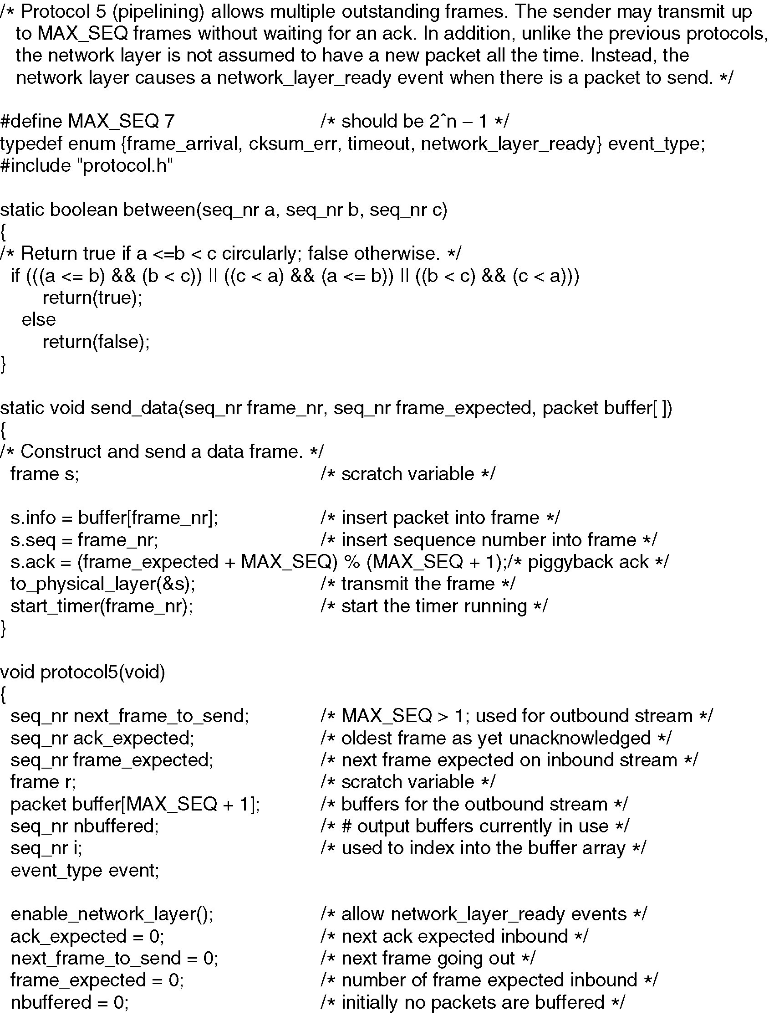

Slide 91
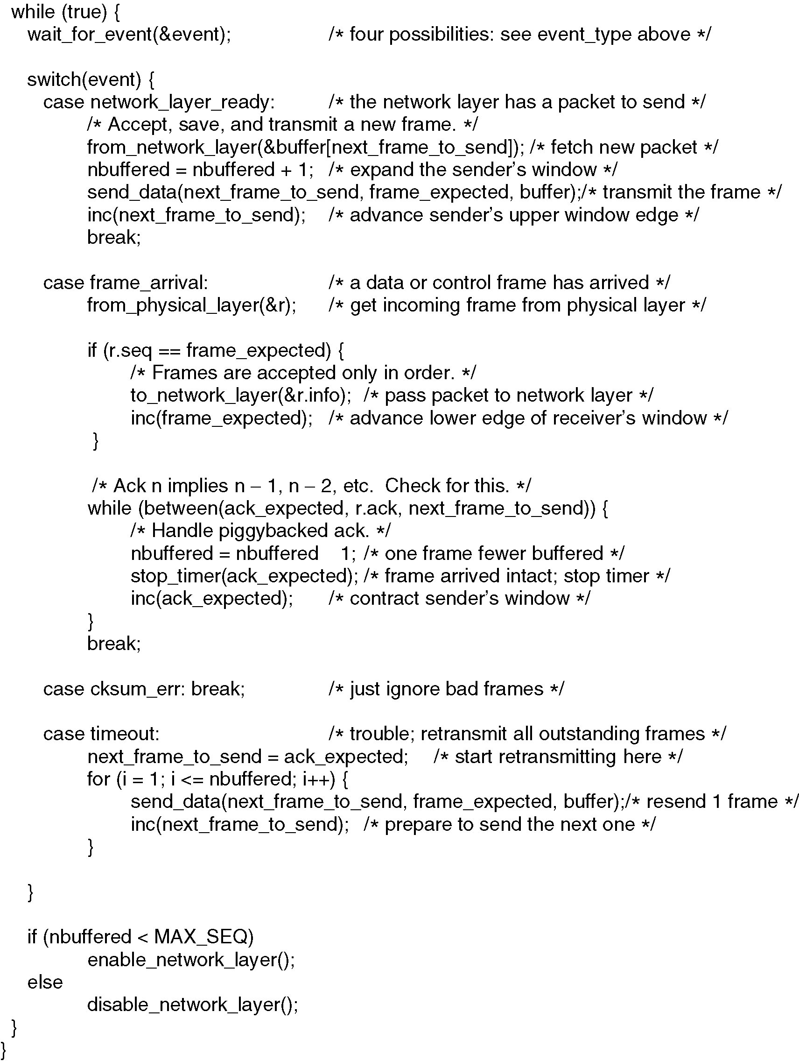

Slide 93
Protocol 5:Go-Back-N Protocol
发送窗口最大值7

Slide 94
Protocol5改进和效率
设置ACK定时器
发送数据并非一个源源不断的分组流，无法及时搭载ACK 时，发送ACK帧
用于回送ACK的定时器start_ack_timer与stop_ack_timer
与数据重传所用定时器start_timer与stop_timer的区别
ACK定时器时限的设计
协议参数与线路利用率
超时定时器时限的设计（考虑线路往返时间延迟，ACK定时器时限，对方物理层发送排队时延）
滑动窗口即MAX_SEQ大小

Slide 95
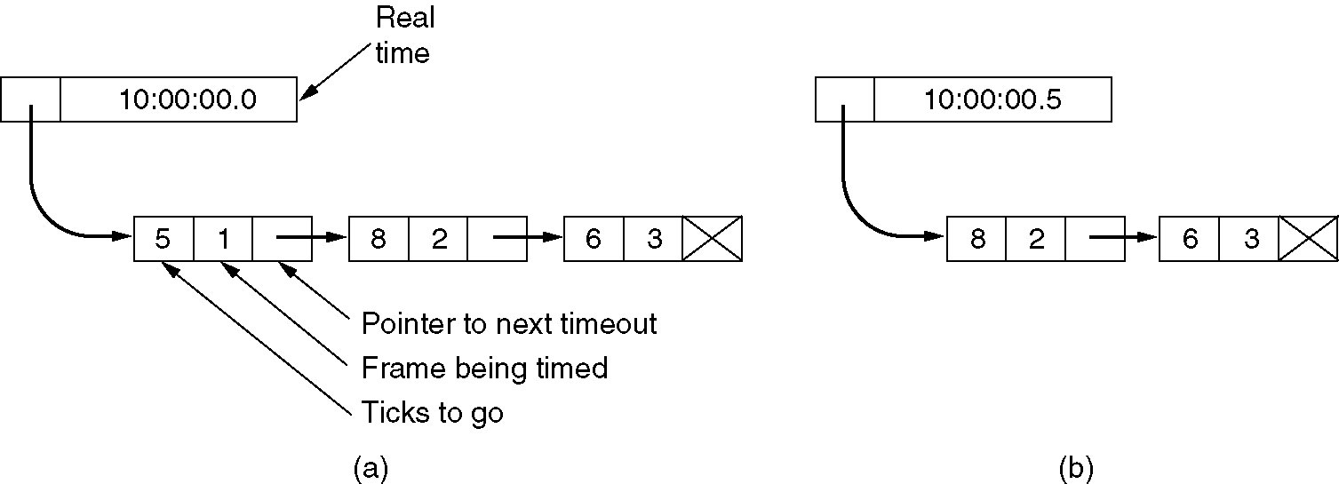
Timer Queue in Software
Simulation of multiple timers in software.

Slide 96
Using Selective Repeat

Slide 97
Selective Repeat
Also called Selective Reject（SR）
Only Rejected frames are retransmitted
Subsequent frames are accepted by the receiver and buffered
Minimizes retransmission
Receiver must maintain large enough buffer
More complex

Slide 98
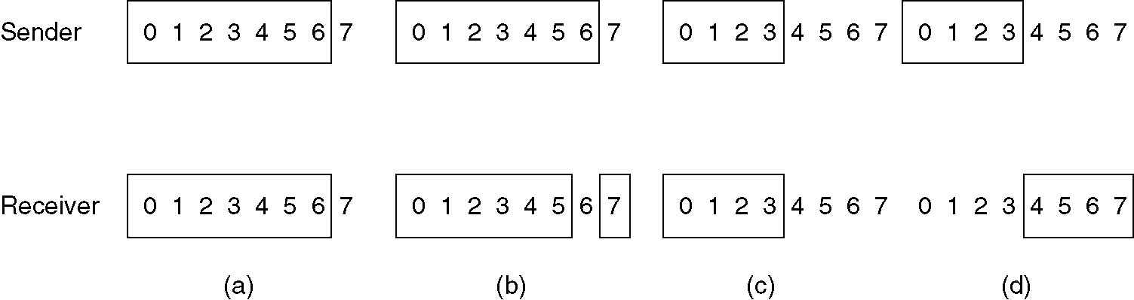
Window Size of Selective Repeat
(a) Initial situation with a window size seven.
(b) After seven frames sent and received, but not acknowledged.
(c) Initial situation with a window size of four.
(d) After four frames sent and received, but not acknowledged

Slide 99
Sequence Number, Buffers
The maximum window size should be at most half the range of the sequence numbers
How many buffers must the receiver have?
The number of buffers needed is equal to the window size, not to the range of sequence numbers

Slide 100
Send Window & Receive Windows
Ws+Wr <=2^{n}
Ws>=Wr
Ws,Wr<= 2^{n} ⁻¹

Slide 101
ACK Timer
ACK timer
After an in-sequence data frame arrives, an auxiliary timer is started by start_ack_timer. If no reverse traffic has presented before this timer expires, a separate ACK frame is sent
The timeout associated with the auxiliary timer be appreciably shorter than the timer used for timing out data frames

Slide 102
NAK
Whenever the receiver has reason to suspect that an error has occurred, it sends NAK frame back to the sender
NAK frame is a request for retransmission
There are two cases when the receiver should be suspicious
A damaged frame has arrived
A frame other than the expected one arrived
To avoid making multiple requests for retransmission of the same frame, the receiver should keep track of whether a NAK has already been sent for a given frame

Slide 103
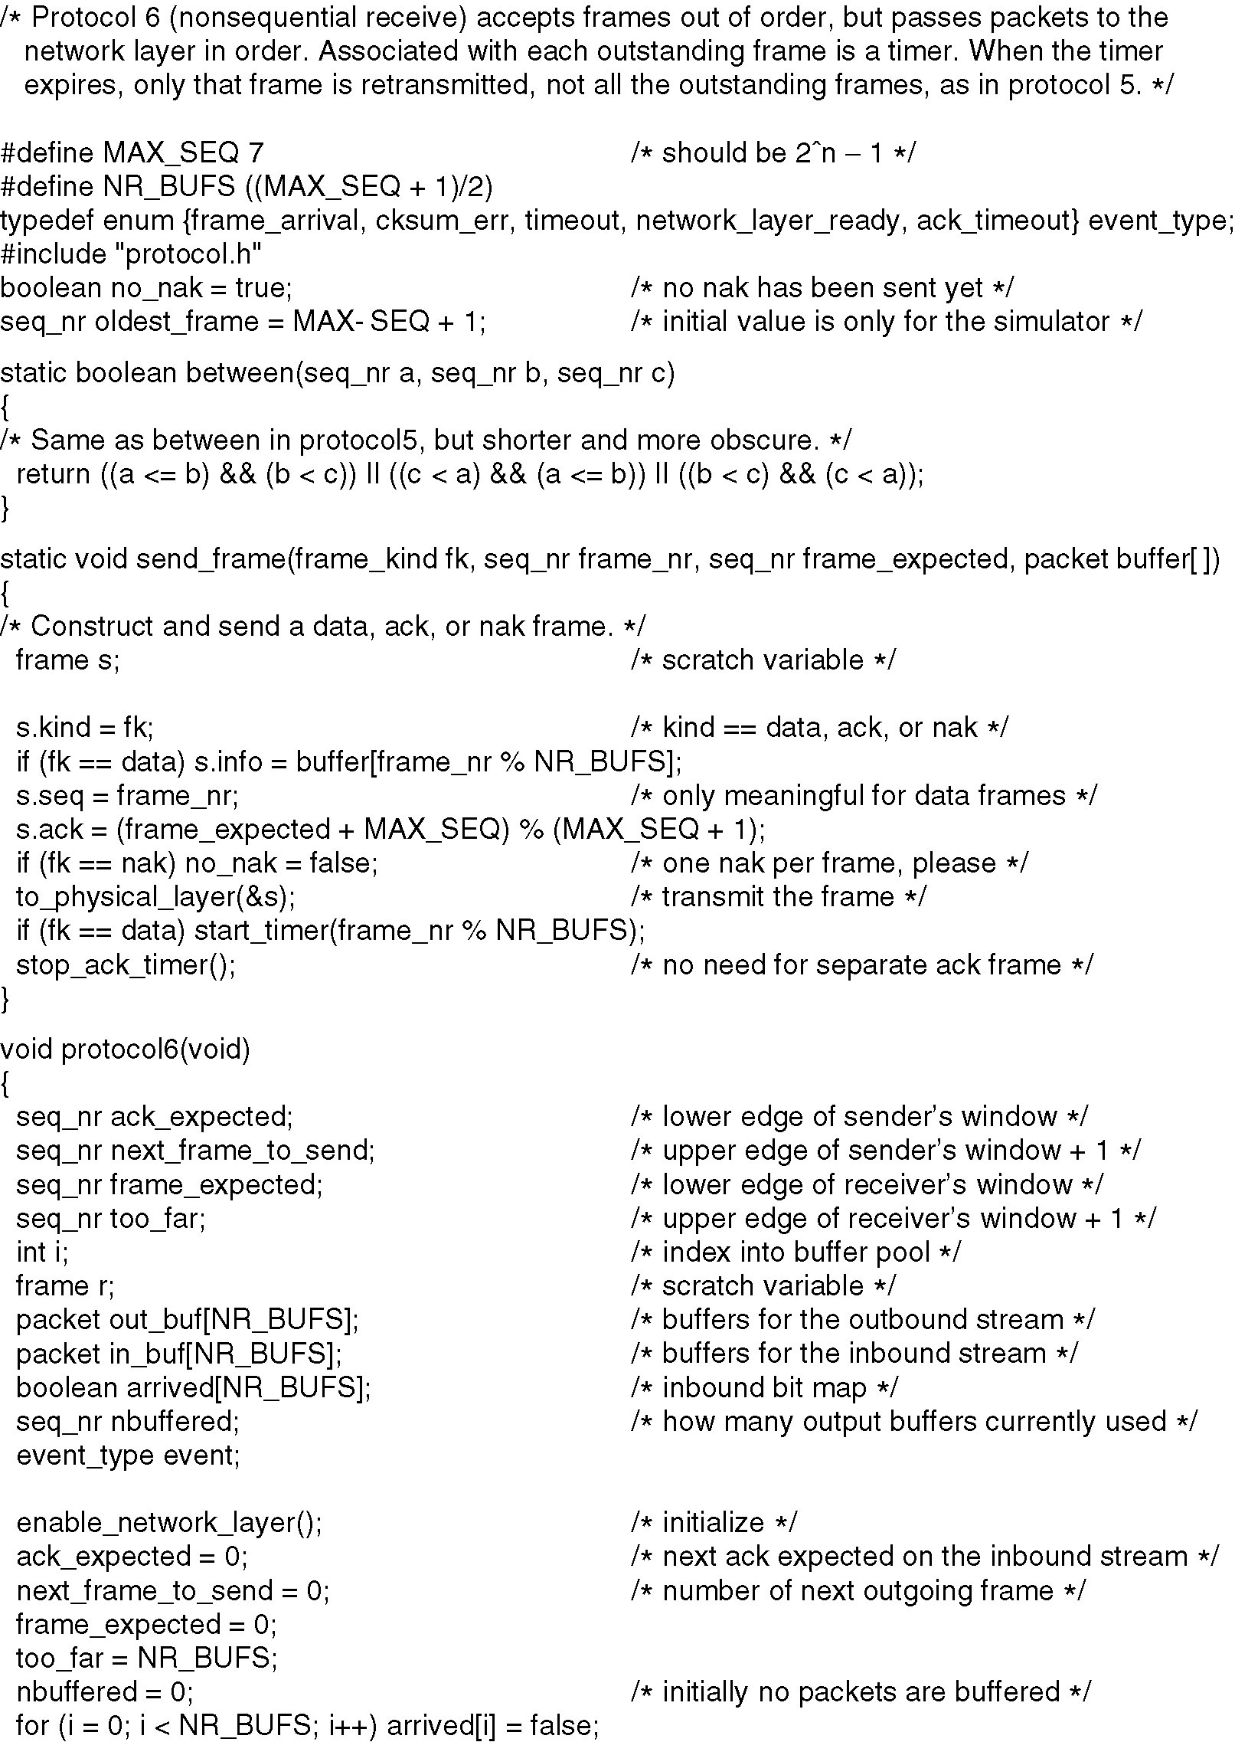
Continued →

Slide 104
Continued →

Slide 105
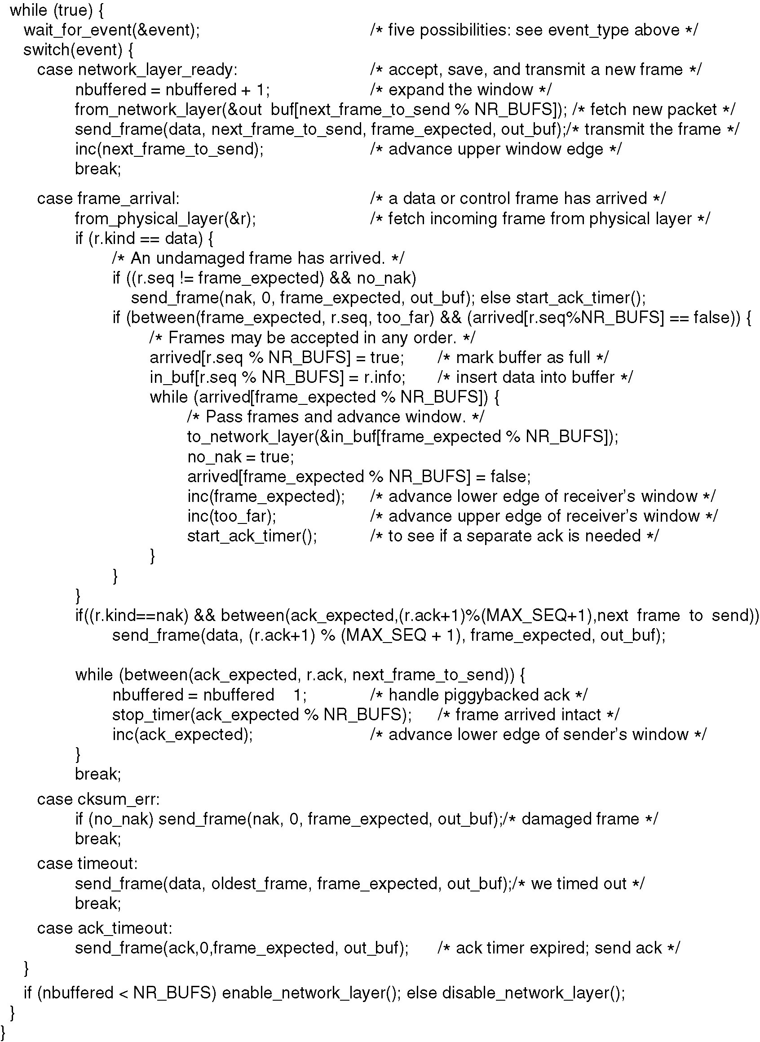
Continued →

Slide 107
3.5 Performance of Sliding Window Protocols

Slide 108
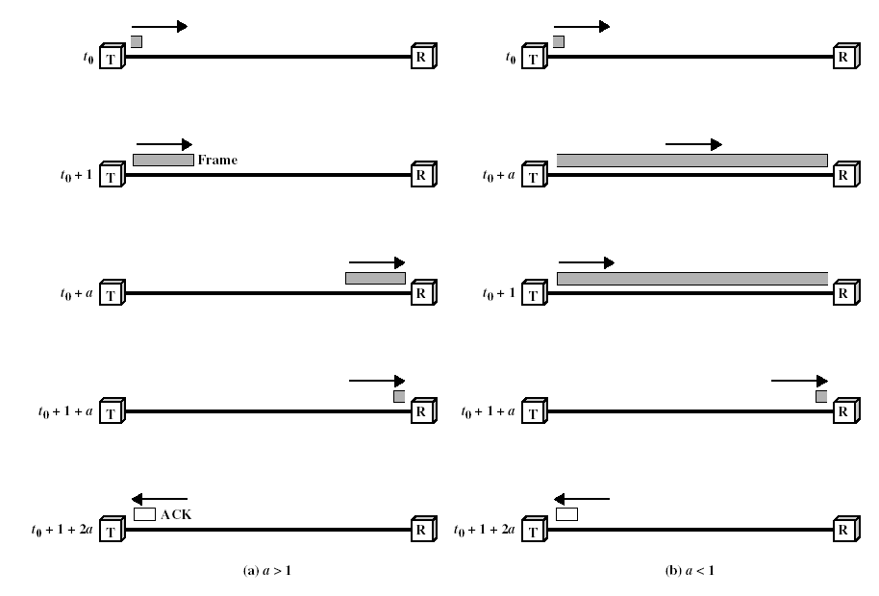
Performance(1)
Stop-and-wait without error(transmission time=1,propagation=a)
a=t_{p}/t_{f}

Slide 109
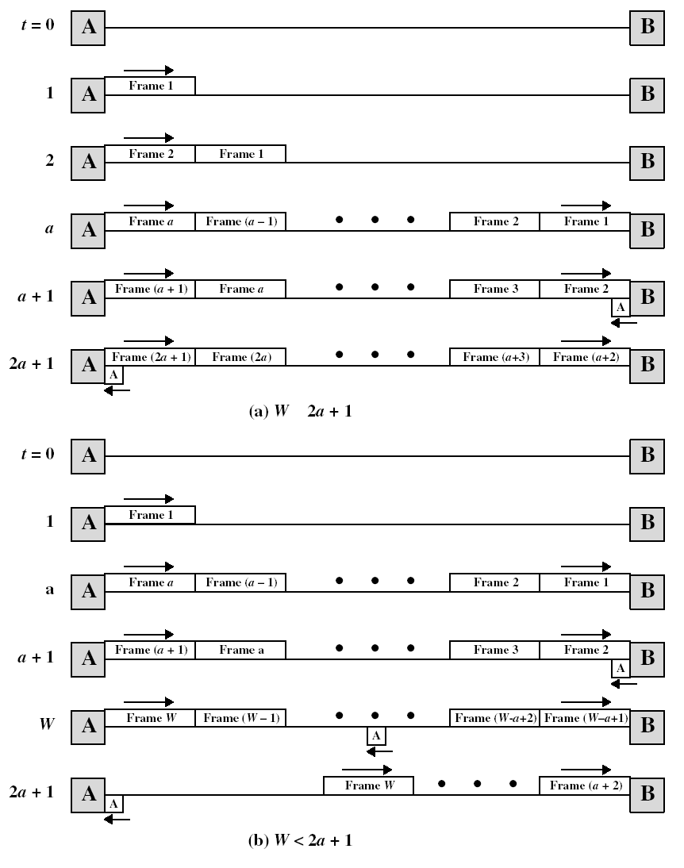
Performance(2)
Slide window without error

Slide 110
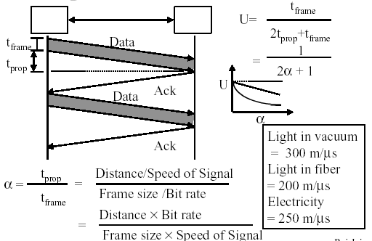
Performance(3)
Stop-and-wait without error

Slide 111
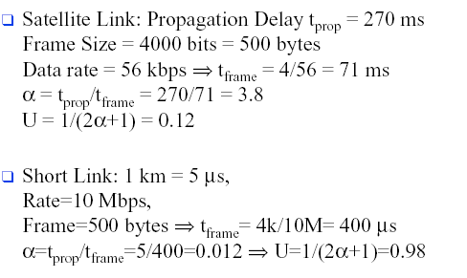
Performance(4)
Stop-and-wait without error

Slide 112
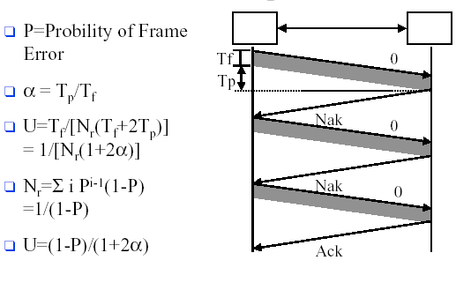
Performance(5)
Stop-and-wait with error

Slide 113
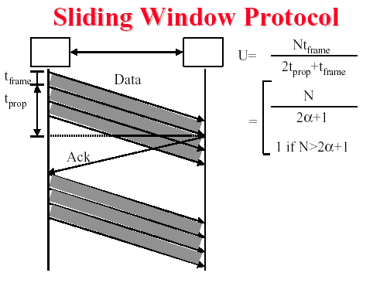
Performance(6)
Slide window without error

Slide 114
Performance(7)
Piggybacking: U=N/(2+2a)

Slide 115
Example
数据链路层采用GBN协议,发送方已经发送了编号为0-7的帧,当计时器超时时,若发送方只收到0,2,3号帧的确认,则发送方需要重发的帧数是?
数据链路层采用SR协议,发送方已经发送了编号为0-7的帧,当计时器超时时,若发送方只收到0,2,3号帧的确认,则发送方需要重发的帧数是?

Slide 116
Example2
Consider a 50-kbps satellite channel with a 500-msec round-trip propagation delay, send 1000-bit frames
使用GBN协议,若使效率达到50%,序号的比特数至少是多少?
0.5=N/(1+2a)
a=250/(1000/50)=12.5

Slide 117
3.6 Example Data Link Protocols

Slide 118
Example Data Link Protocols
HDLC – High-Level Data Link Control
The Data Link Layer in the Internet
SLIP (Serial Line IP)
PPP (Point-to-Point Protocol)
PACKET over SONET
ADSL

Slide 119
HDLC
(High-Level Data Link Control)

Slide 120
History
IBM SDLC ,1974
Synchronous Data Link Control
ANSI ADCCP
Advanced Data Communication Control Procedure
ISO HDLC
High-level Data Link Control
CCITT(ITU-T) LAPB
LAP (Link Access Procedure)
LAPB (Link Access Procedure – Balanced mode)

Slide 121
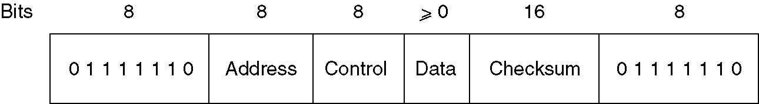
HDLC Frame format
Frame format for bit-oriented protocols.

Slide 122
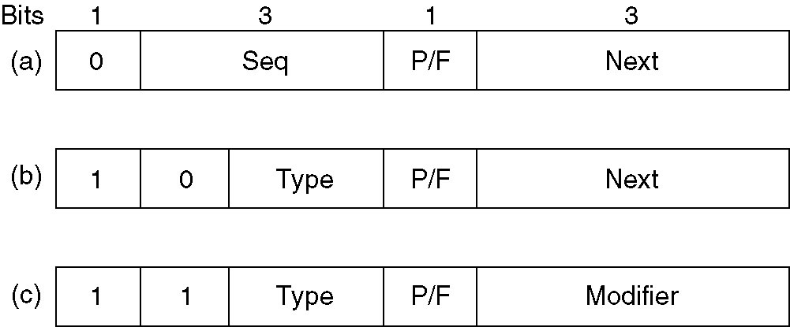
HDLC Frames
Control field of
(a) An information frame. (I)
(b) A supervisory frame. (RR/RNR/REJ/SREJ)
(c) An unnumbered frame.(SABM,UA,DISC,FRMR)
First one or two bits of control filed identify frame type

Slide 123
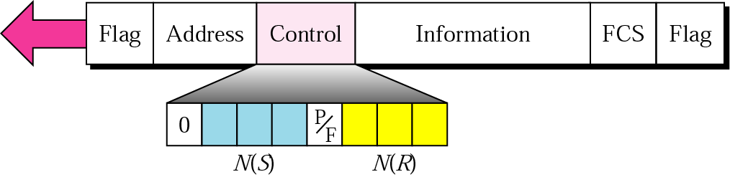
I-frame
If the first bit of the control field is 0, this means the frame is an I-frame.
3-bit N(S)
1-bit P/F
3-bit N(R)

Slide 124
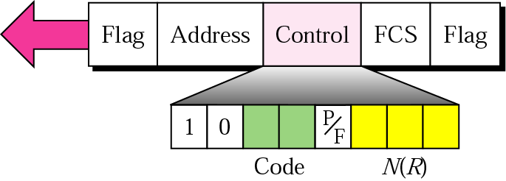
S-frame Control Field
If the first 2 bits of the control field are 10, this means the frame is an S-frame.
Code
RR, RNR, REJ, SREJ (3-bit N(R))

Slide 125
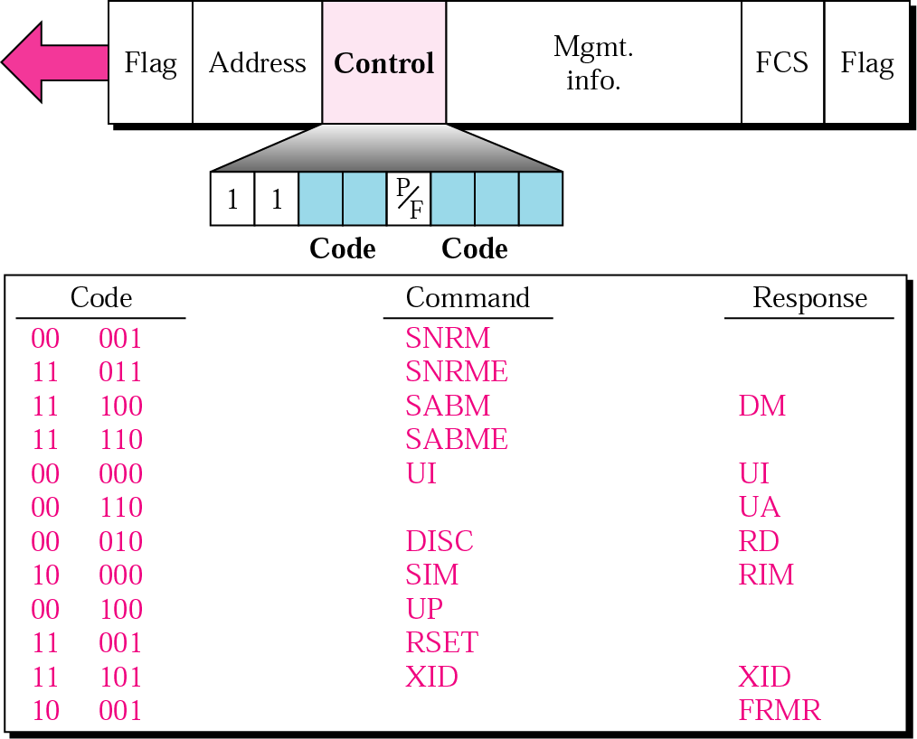
U-frame

Slide 126
P/F Bit
Use depends on context
Unbalanced configuration
Poll: Invite the terminal to send data
Final: All the frames sent by the terminal, except the final one, have the P/F bit set to 0. The final one is 1
Balanced configuration
Command (P bit): P=1 to solicit (poll) response from peer
Response (F bit): F=1 indicates response to soliciting command
Force the other machine to send a Supervisory frame immediately rather than waiting for reverse traffic onto which to piggyback the window information

Slide 127
ACK Frame: RR & RNR
RR: Reveiver Ready
ACK frame used to indicate the N(R) frame expected
This frame is used when there is no reverse traffic to use for piggybacking
RNR: Reveiver Not Ready
It acknowledges all frames up to but not including N(R) , just as RR does, but it tells the sender to stop sending (Flow control)

Slide 128
NAK Frame: REJ & SREJ
REJ: Reject
Indicate that a transmission error has been detected
The N(R) field indicates the first frame in sequence not received correctly (i.e., the frame to be retransmitted)
The sender is required to retransmit all outstanding frames starting at N(R)
SREJ: Selective Reject
Calls for retransmission of only the frame specified by N(R)
If a receiver wishes to buffer out-of-sequence frames for potential future use, it can force the retransmission of any specific frame using SREJ

Slide 129
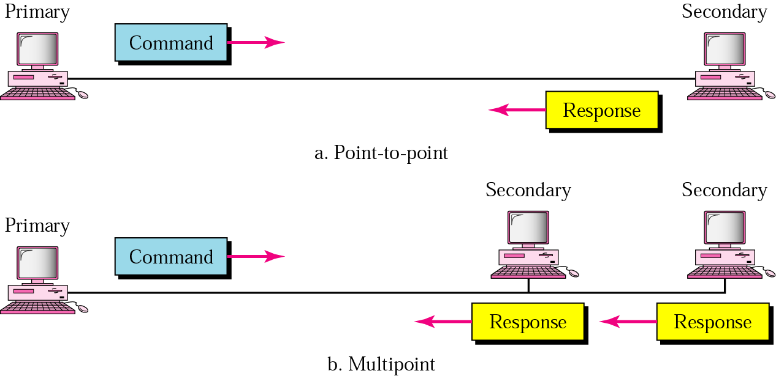
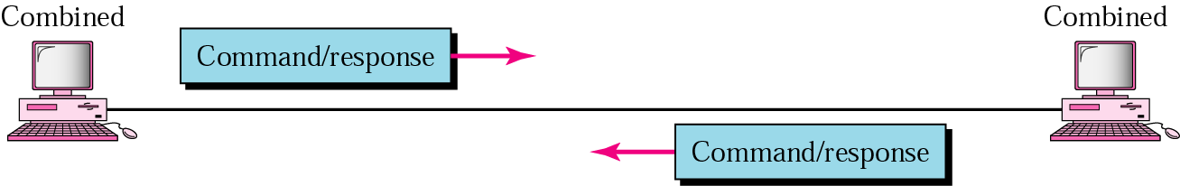
HDLC Station Types
Primary station
Controls operation of link
Frames issued are called commands
Maintains separate logical link to each secondary station
Secondary station
Under control of primary station
Frames issued called responses
Combined station
May issue commands and responses

Slide 130
HDLC Link Configurations
Unbalanced
One primary and one or more secondary stations
Supports full-duplex and half-duplex
Balanced
Two combined stations
Supports full-duplex and half-duplex

Slide 131
HDLC Operation
Exchange of information, supervisory and unnumbered frames
Information - data to be transmitted to user (next layer up)
Flow and error control piggybacked on information frames
Supervisory - ARQ when piggyback not used
Unnumbered - supplementary link control
Three phrases
Initialization
Data transfer
Disconnect

Slide 132
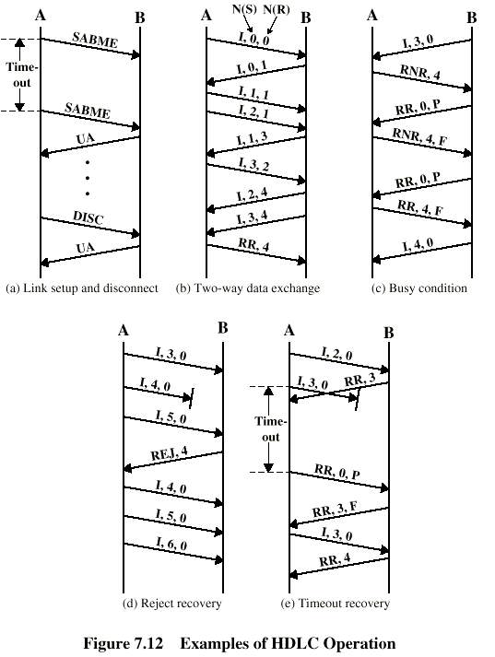
Example of HDLC Operation

Slide 133
Example of HDLC Operation

Slide 134
SLIP
(Serial Line IP)

Slide 135
SLIP – Serial Line Internet Protocol
RFC1055
Framing: Character Stuffing
Use 0xC0 as a flag char
Use 0xDB 0xDC to replace 0xC0
Use 0xDB 0xDB to replace 0xDB
Problems
No error control
Only support IP
Don’t assign IP address dynamically
No authentication
Different version exist

Slide 136
PPP
(Point to Point Protocol )

Slide 137
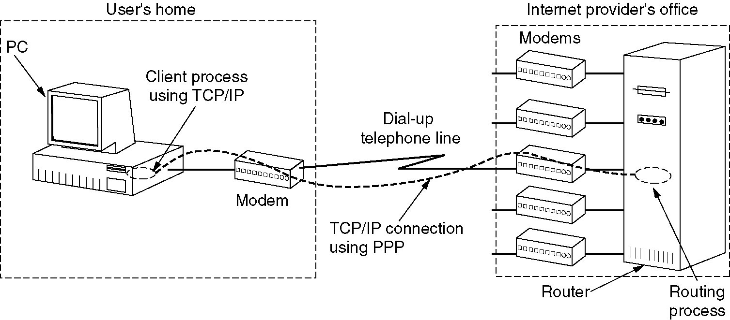
The Data Link Layer in the Internet
A home personal computer acting as an internet host.

Slide 138
PPP Protocol Sub-layers
IP
IPX
Third Layer
IPCP
IPXCP
Others
NCP
PPP
LCP
PHYSICAL

Slide 139
Multiple protocols
TCP/IP
Novell IPX
…...
PPP encapsulation

Slide 140
PPP - Point to Point Protocol
Protocol specifications:
RFC1661,1662,1663
Features:
Layer 1
Synchronous circuits (bit-oriented encodings)
Asynchronous circuits (byte-oriented encodings)
PPPoE (PPP over Ethernet, ADSL)
LCP: Link Control Protocol
Error detection (CRC)
Permits authentication
Allows IP addresses to be negotiated at connection time
Multiple protocols: NCP(IP, IPX, …)

Slide 141
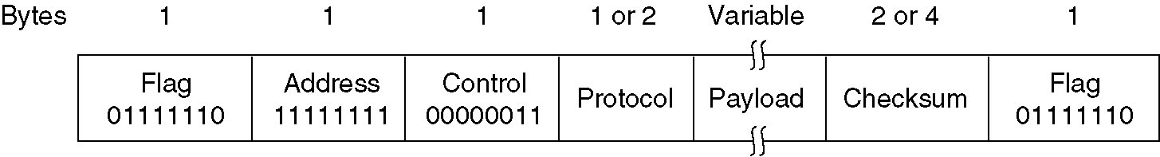
PPP Frame Format
The PPP full frame format for unnumbered mode operation.

Slide 142
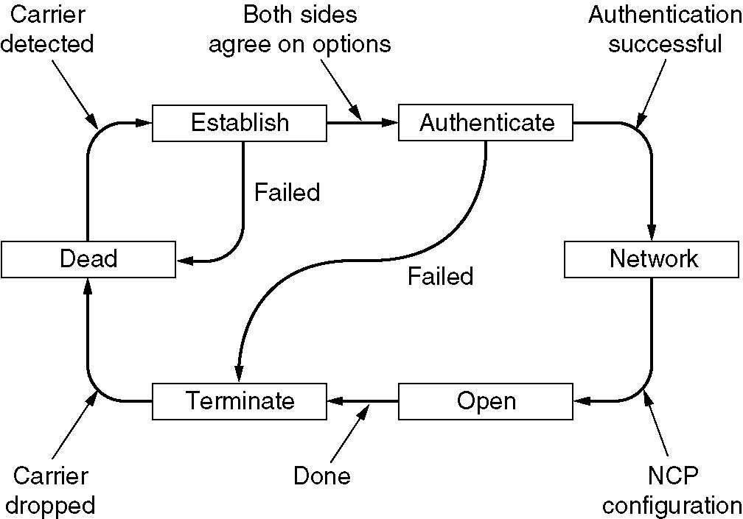
PPP Phase Diagram
A simplified phase diagram for bring a line up and down.

Slide 143
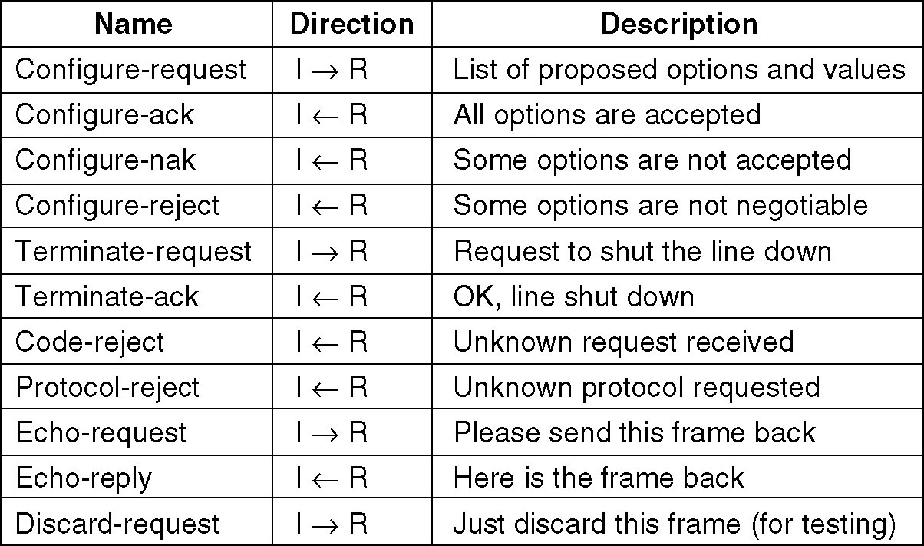
LCP Frame Types
The LCP frame types.

Slide 144
LCP Negotiates Protocol Options(1)
Max payload size for data frames(1500)
Authentication and choosing a protocol to use
PAP：Password Authentication Protocol
CHAP: Challenge Handshake Authentication Protocol
Line-quality monitoring during normal operation
Compression: Header and Data compression scheme
Stacker
Predictor
Zlib

Slide 145
LCP Negotiates Protocol Options(2)
CRC options
异步方式，字节填充法，指定转义字符集ACCM (Async-Control-Character-Map, 32 bits，用bitmap指定需转义的ASCII 码的控制字符集合)
0x7E==>0x7D, 0x5E (0x7E为FLAG)
0x7D==>0x7D, 0x5D
控制字符C==> 0x7D，C xor 0x20 (C < 0x20)
Multilink Protocol (MP)
ISDN (2B+D)

Slide 146
CHAP Example
CHAP_REQUEST (Challenge-ID, server-name) 12618764(4-bytes Random), routerA
CHAP_RESPONSE (response, client-name) , Ty7ic#oM9@S...(16-bytes MD5), zhang
CHAP_SUCCESS/CHAP_FAILURE

Slide 147
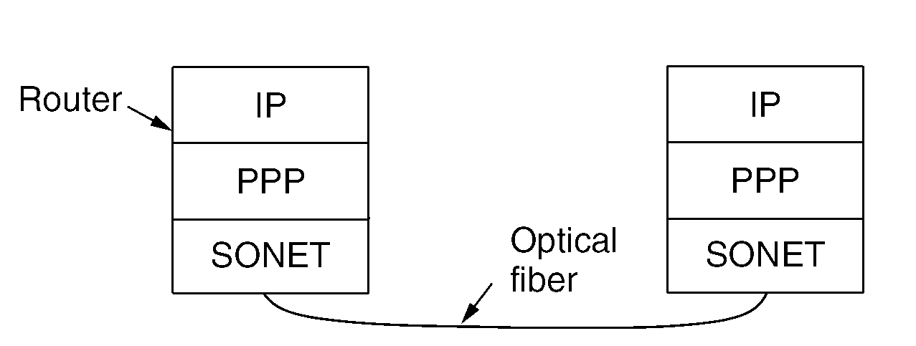
Packet over SONET
SONET
the physical layer protocol that is used over the wide-area optical fiber links that make up the backbone of communications networks, including the telephone system.
provides a bitstream that runs at a well-defined rate, for example 2.4 Gbps for an OC-48 link, some framing mechanism is needed.

Slide 148
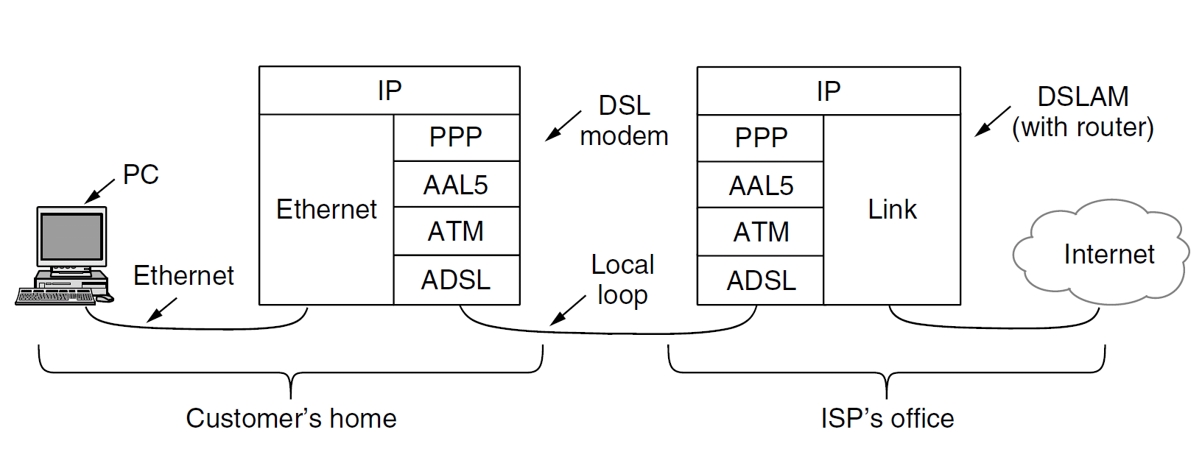
ADSL Protocol stacks
AAL5(ATM Adaptation Level 5)
Framing and CRC
ATM
ATM fixed-size cell (5-byte head and 48-byte payload)
ADSL physical layer
Reed-Solomon code for error correction
1-byte CRC, error detection
DMT (Discrete MultiTone), QAM modulation

